Slide 1
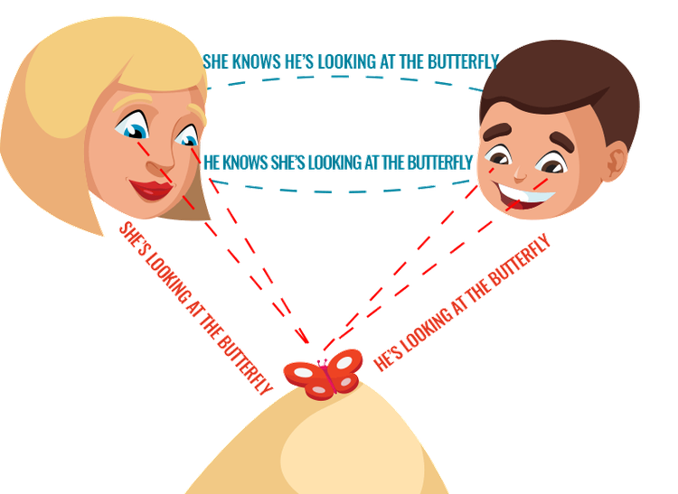
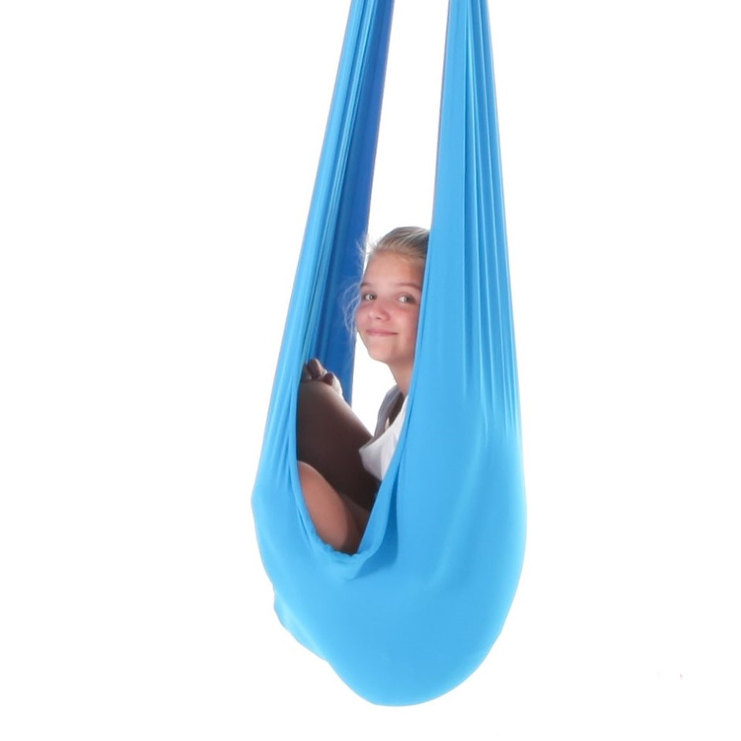
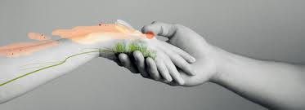
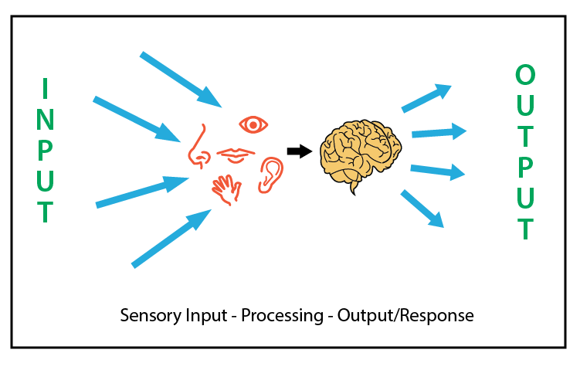
Effects of Sensory Processing Impairments on Social Language Skills in Children with Autism Spectrum Disorder
Sara Stier, Supervised by Dr. Elaine Pyle
Speech-Language Pathology, Minnesota State University Moorhead, 1104 7th Avenue South, Moorhead, MN 56563
Abstract:
Autism Spectrum Disorder (ASD) is a neurodevelopmental disorder that is commonly characterized by impairments in social communication, language, and other cognitive skills, behavior and emotional challenges, sensory processing issues, and feeding challenges (ASHA, n.d.). Sensory processing refers to the process of the central nervous system receiving input from the senses and integrating this information to generate an appropriate behavioral response (Kojovic et al., 2019). A highly regulated sensory system is a vital piece that is needed in order to be able to communicate wants, needs, and ideas effectively and appropriately (Sensory Issues, n.d.). The main sensory systems that individuals with ASD may have sensitivities to include visual, auditory, olfactory, gustatory, tactile, vestibular, proprioception, and interoception (Sensory Issues, n.d.).
There are multiple ways that individuals with autism respond to sensory stimuli. Kojovic et al (2019), explained that it may be caused by hyperresponsiveness, hyporesponsiveness, or a combination of both. When the brain has to put all of its resources and effort into processing overwhelming sensory information, the other major functions including speech, social skills, decision-making skills, and information processing may be inhibited (Sensory Issues, n.d.). This often imposes detrimental effects on the individual’s overall communication abilities. Since Piller and Barimo (2019) indicate that 70-96 percent of individuals with ASD have some degree of sensory processing difficulties, it is vital that this is considered when aiming to create a communication-friendly environment for them by implementing various sensory strategies.
Visual and Auditory Systems:
When engaging with social scenes, children with higher levels of hyporesponsiveness had more divergent visual exploration patterns than typically developing children (Kojovic et al., 2019)
Atypical visual processing affects joint attention, the predominant way children learn from others (Mundy & Jarrold, 2010)
Individuals with ASD have enhanced pitch perception, increased sensitivity to loud noises, impaired auditory orientation, and perception of prosody issues (Baker et al., 2007)
One of the earliest predictors of ASD is the failure to attend to auditory stimuli (Thye et al., 2018)
Accommodations:
Sensory processing difficulties should be considered for a communication-friendly environment (Piller & Barimo., 2019)
Regulated sensory system = optimal communication abilities
Vestibular: jumping, swinging
Proprioceptive: weight bearing, climbing
Tactile: deep pressure massages or squishes (Piller & Barimo., 2019)
Environmental modifications/accommodations
Lighting, noise levels, scents, location, visual distractions (sensory issues., n.d.)
Autilius. (n.d.). https://www.autilius.pl/en/about//joint-attention
How “social touch” shapes autism traits. Spectrum. (2023, September 15). https://www.spectrumnews.org/features/deep-dive/social-touch-shapes-autism-traits/
Alisha Grogan MOT, O. (2024, January 14). Top 10 sensory swings for kid’s development and sensory processing. Your Kid’s Table. https://yourkidstable.com/sensory-swings/
Tactile, Olfactory, Gustatory Systems:
Tactile stimulation is important for developing social bonds, overall physical development, and the development of brain areas associated with social cognition (Thye et al., 2018)
Hypersensitivity to touch may lead to negative feelings surrounding it (Kojovic et al., 2019)
The amygdala and orbitofrontal cortex impact eating difficulties and smell sensitivities, along with the social network (Thye et al., 2018)
References
American Speech-Language-Hearing Association. (n.d.). Autism spectrum disorder. American Speech-Language-Hearing Association. https://www.asha.org/practice-portal/clinical- topics/autism/
Baker, A. E. Z., Lane, A., Angley, M. T., & Young, R. L. (2007, September 25). The relationship between sensory processing patterns and behavioural responsiveness in autistic disorder: A pilot study - journal of autism and developmental disorders. SpringerLink. https://link.springer.com/article/10.1007/s10803-007-0459-0
Baranek, G. T., Watson, L. R., Boyd, B. A., Poe, M. D., David, F. J., & McGuire, L. (2013).
Hyporesponsiveness to social and nonsocial sensory stimuli in children with autism, children with developmental delays, and typically developing children. Development and psychopathology. https://www.ncbi.nlm.nih.gov/pmc/articles/PMC3641693/
Hilton, C. L., Harper, J. D., Kueker, R. H., Lang, A. R., Abbacchi, A. M., Todorov, A., & LaVesser, P. D. (2010). Sensory responsiveness as a predictor of social severity in children with high functioning autism spectrum disorders. Journal of Autism and Developmental Disorders, 40(8), 937–945. https://doi.org/10.1007/s10803-010-0944-8
Kelly, K. (2022). How sensory processing can affect motor skills: Proprioception and Vestibular Sense. Understood. https://www.understood.org/en/articles/how-sensory-processing-issues- can-affect-motor-skills
Kern, J. K., Garver, C. R., Grannemann, B. D., Trivedi, M. H., Carmody, T., Andrews, A. A., & Mehta, J. A. (2007). Response to vestibular sensory events in autism. Research in Autism Spectrum Disorders, 1(1), 67–74. https://doi.org/10.1016/j.rasd.2006.07.006
Kojovic, Ben Hadid, Franchini, & Schaer. (2019). Sensory processing issues and their association with social difficulties in children with autism spectrum disorders. Journal of Clinical Medicine, 8(10), 1508. https://doi.org/10.3390/jcm8101508
Morin, A. (2021, November 18). Heavy work activities and sensory processing disorder. Understood. https://www.understood.org/en/articles/heavy-work-activities
Mundy, P., & Jarrold, W. (2010). Infant joint attention, neural networks and social cognition. Neural networks: the official journal of the International Neural Network Society. https://www.ncbi.nlm.nih.gov/pmc/articles/PMC2963105/
Piller, A., & Barimo, J. (2019). Sensory strategies to calm and engage children with autism spectrum disorder. The ASHA Leader, 24(4), 56–63. https://doi.org/10.1044/leader.ftr2.24042019.56
Sensory issues. Autism Speaks. (n.d.). https://www.autismspeaks.org/sensory-issues
Thye, M. D., Bednarz, H. M., Herringshaw, A. J., Sartin, E. B., & Kana, R. K. (2018). The impact of atypical sensory processing on social impairments in autism spectrum disorder. Developmental Cognitive Neuroscience, 29, 151–167. https://doi.org/10.1016/j.dcn.2017.04.010
Sensory processing disorder. Child Success Center. (2022, October 13). https://childsuccesscenter.com/home/resources/sensory-processing/
Vestibular and Multisensory Systems:
“Normal vestibular processing helps us to orient ourselves to our world. Being able to orient in space may be crucially important in the understanding of other sensory information ” (Kern et al., 2007)
Multisensory stimuli has the most detrimental effects when a sensory processing disorder is present (Hilton et al., 2010) (Kojovic et al., 2019)
Social interactions are multisensory by nature (Hilton et al., 2010)
Cortices, subcortical regions, and cerebellum need to be highly synchronized to process and interpret stimuli (Hilton et al,. 2010)
Autism Spectrum Disorder (ASD) and Sensory Processing:
ASD is characterized by impairments in social communication, language, cognitive skills, behavior and emotional challenges, feeding challenges, and sensory processing issues (ASHA, n.d.)
Sensory processing refers to the central nervous system receiving input and integrating the information into an appropriate response (Kojovic et al., 2019)
Individuals may respond hypersensitively (sensory avoidance) or hyposensitively (sensory-seeking) (ASHA, n.d.)
When children do not respond to sensory stimuli as they typically are expected to, they miss a variety of learning opportunities within daily environments (Baranek et al., 2013)
Evaluate this poster
Presentation ID: 9496
Scan the QR Code or go to:
https://bit.ly/sac2023-eval

