Slide 1
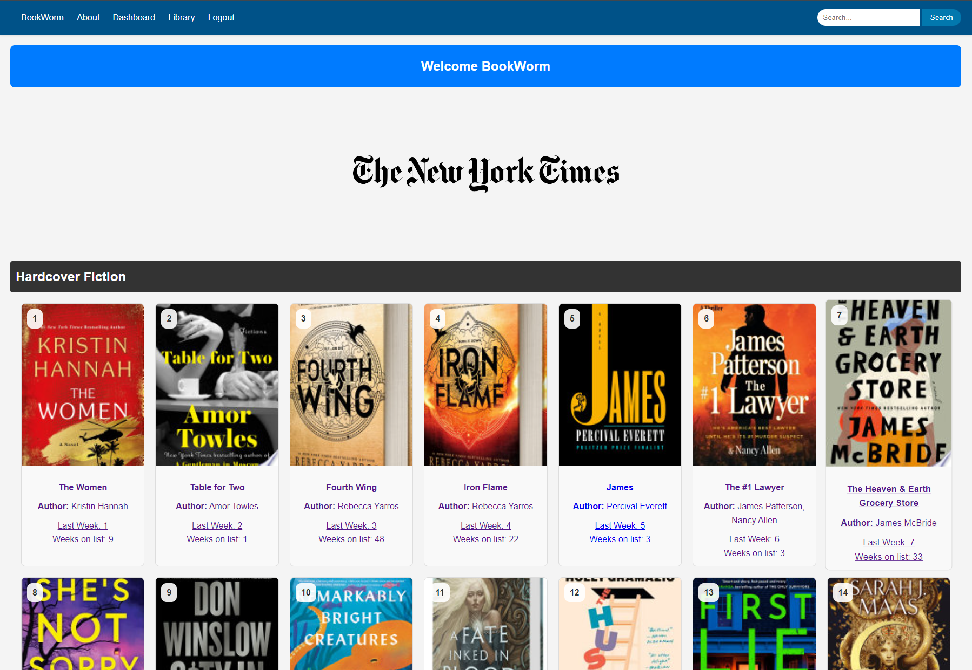
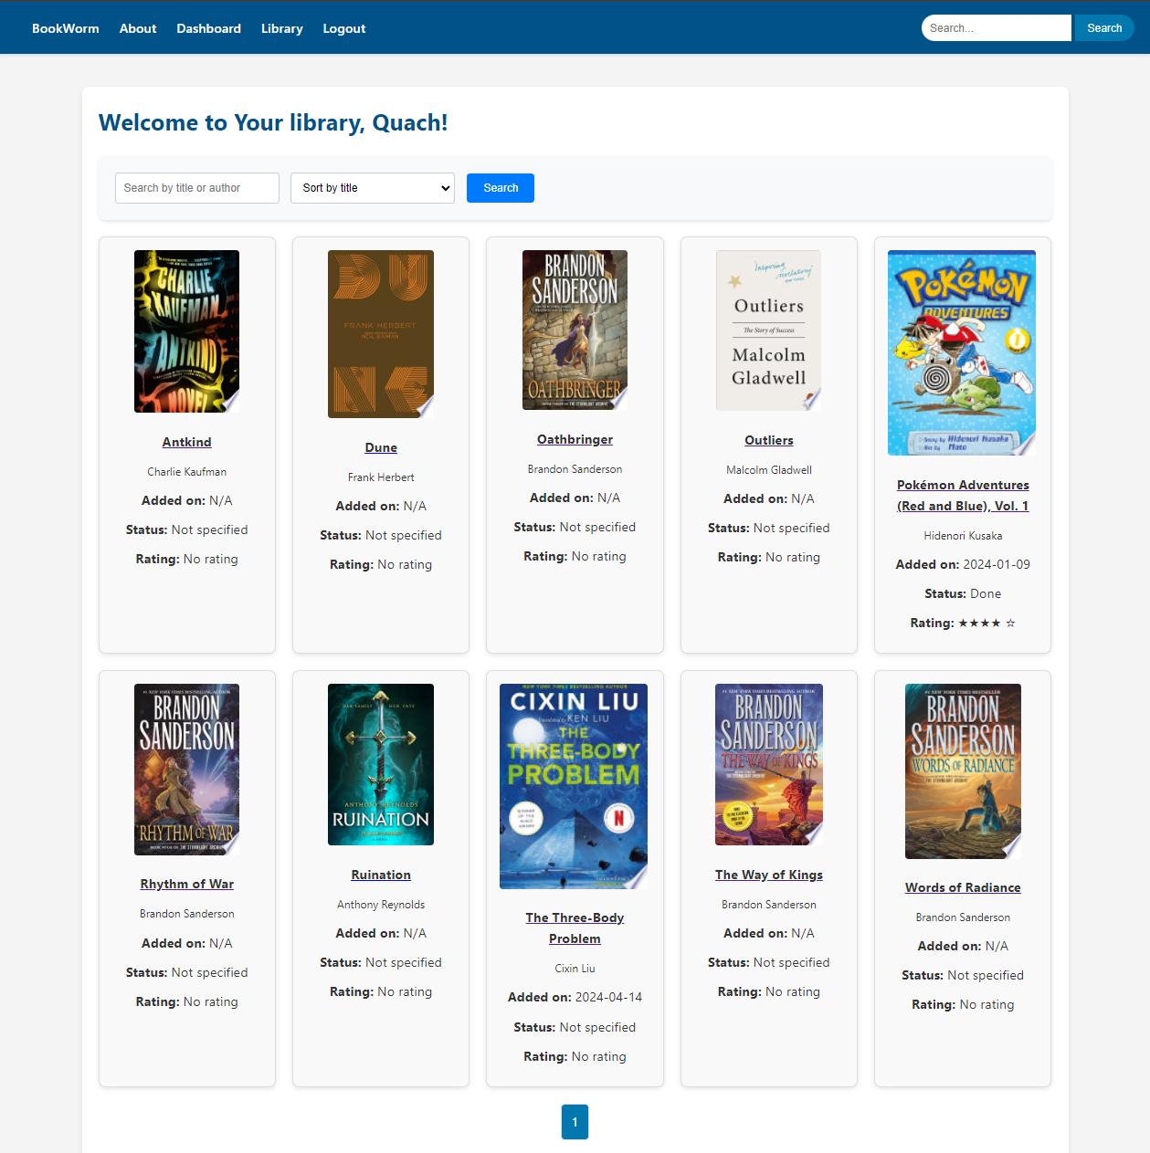
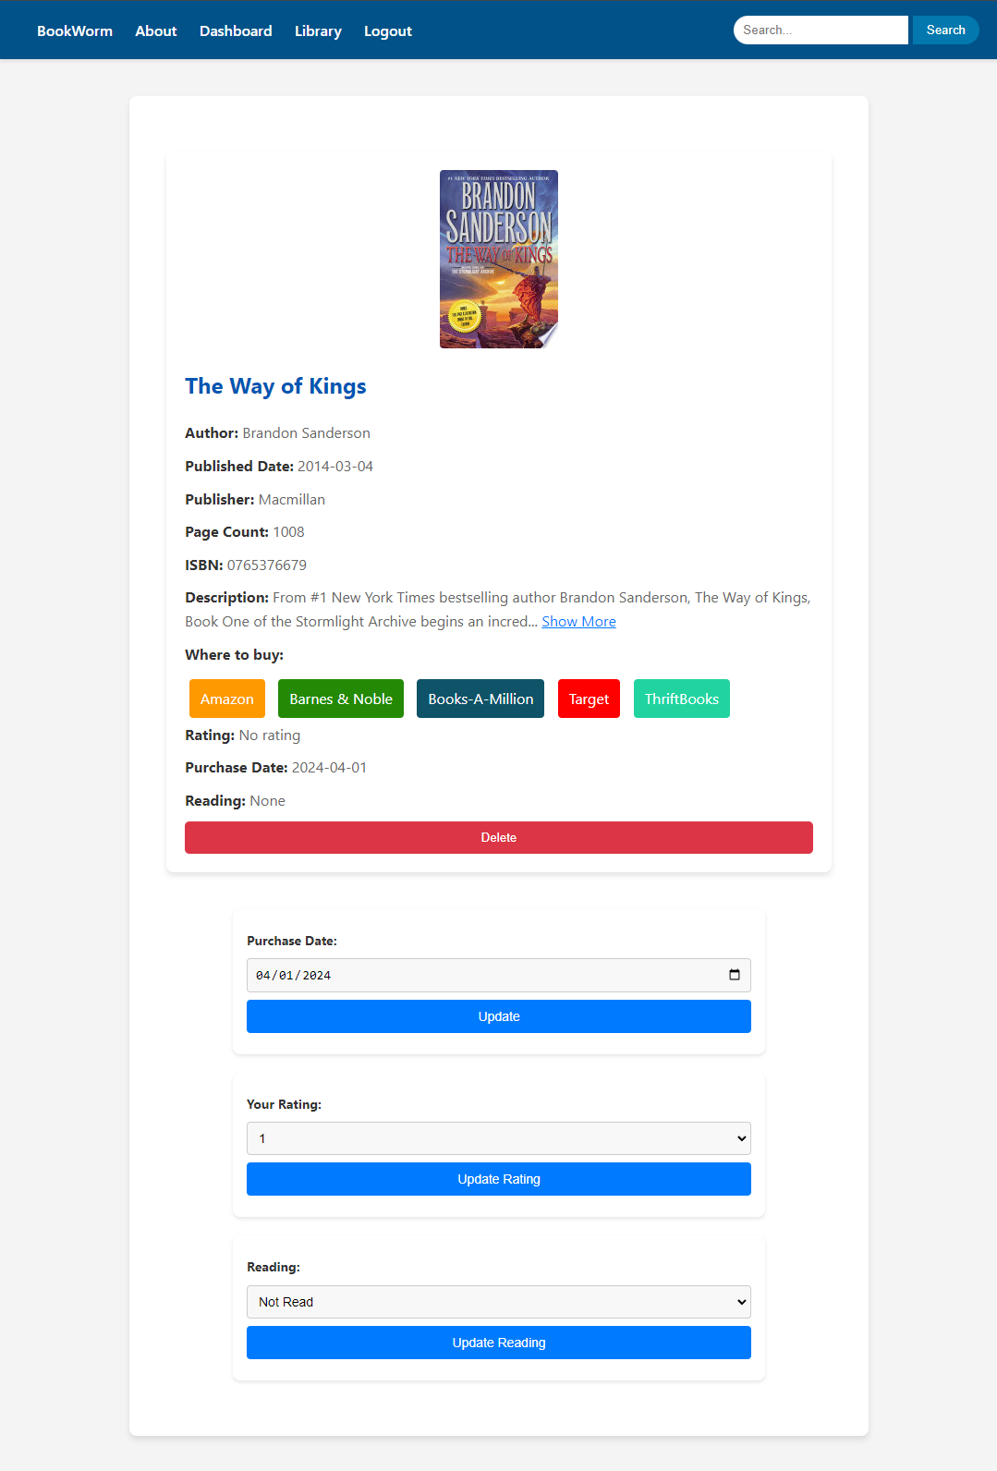
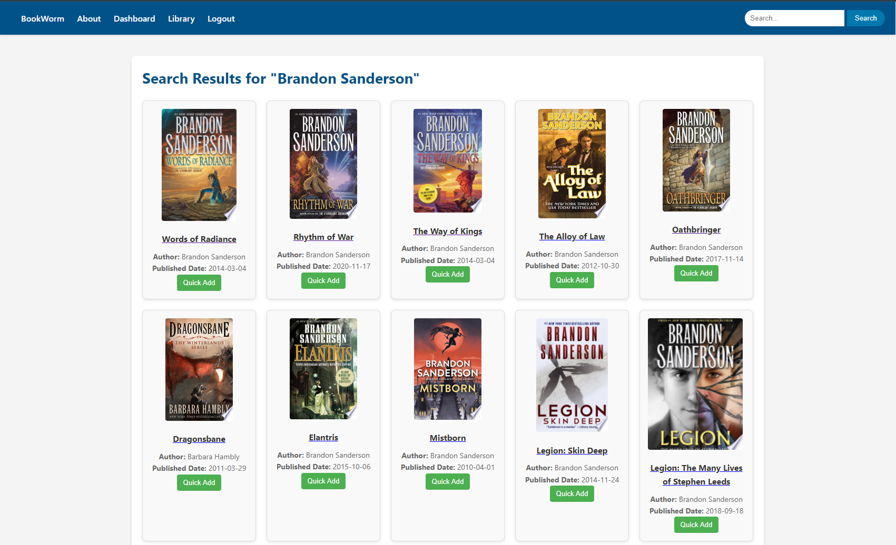
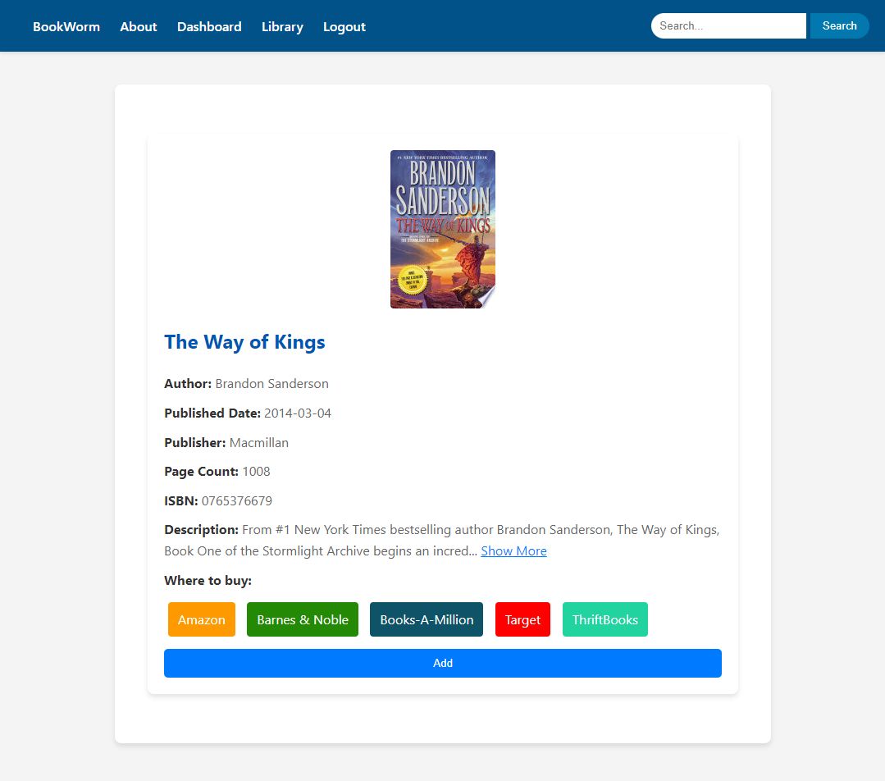
BookWorm:
A Home Library Aid
Johnny Quach
Department, Minnesota State University Moorhead, 1104 7th Avenue South, Moorhead, MN 56563
Abstract:
This project involved the design and development of a website intended to allow users to create a personal inventory of their purchased media with a primary focus on books. The goal of the project was to create a website that is both user-friendly, convenient, and both personally and professionally useful. The project began with an analysis of existing personal inventory websites and apps which identified many different aspects that are included in the finished website, as well as aspects that fell short. Utilizing Python and Flask, the design includes a number of easy-to-use features, such as the ability to create an account to save a personal library and the ability to use the search engine by manually typing or using a barcode scanner. Through this project, users can expect enhanced organization, tracking, and accessibility of their media collections, promising an enjoyable experience for both casual and avid collectors alike.
Meet BookWorm
Programming/Framework:
Research for BookWorm began with looking into different frameworks in order to determine which would be the best fit. Ultimately, this research led to Python and Flask. Python is widely used in many areas like web development, data analysis, and AI. Its compatibility with web development made it a great choice for where this project was headed. Flask is a web application framework that is written in Python. It was designed to make starting a web application quick and easy but allows for the possibility of more complex situations. With Python’s simplicity and Flask’s flexibility, BookWorm began taking form.
Figure 4: Your Library
This page displays all books that have been added to a user’s library. BookWorm gives options to search within added books or to sort all added books by title, rating, purchase date, or read status. If a user has submitted a star rating to their book, this will also be displayed here.
Figure 5: Personal Touches
Once a book is added to the user’s library, BookWorm gives the options of adding a purchase date, a star rating, and a read status. This allows users to add small personal touches to each library.
Figure 1: Home Page.
This is the page users are greeted with when first visiting the website. The New York Times best sellers are featured here and are updated every Sunday when the lists are refreshed. Users can navigate to the Login page from here to create their own account and start adding books to their library.
Looking Ahead:
While there are many great things that the current BookWorm website offers, there are still more ideas that haven’t been implemented. A couple of these include the option for users to create wish lists of books they want to buy in the future and the possibility to add other types of physical media other than books, such as movies, music, or video games. User interaction is also a big possibility that could be implemented in the future, giving users the ability to follow each other and see what their friends are reading.
Along with these big upgrade possibilities come smaller ones, such as adding more filters to the library page and improving the book catalog to include a larger range of books. Currently, most books can be found within BookWorm, however, there may be some titles and forms of books (i.e., manga and other graphic novels) that may not be accounted for.
BookWorm is in its early stages and has a lot of potential to grow into something more.
Deployment:
In order to take BookWorm from coding and make it into a usable website, a website application service was needed. Research into the topic found Heroku, a cloud platform service that allows developers to build, run, and operate their applications entirely in the cloud. On top of this, Heroku provides provision management and server maintenance needed to keep web applications up and running. Heroku also offers scalable databases which were able to be utilized within this project to store information such as user sign up and personalized user input.
API’s:
Google Books API:
Google Books API is the backbone of BookWorm. Without it, this project would have been almost impossible to complete.
Google Books API is a service provided by Google that allows developers to access and utilize data from Google Books, which includes a large index of books from publishers, libraries, and booksellers. This API is where BookWorm gets all of its book information, including cover art, title, author, publish date, ISBN, and book descriptions.
The New York Times Book API:
The New York Times Books API was primarily used for the Home Page of BookWorm to display the current best-selling books as a greeting to users visiting the website.
The New York Times Books API is a service provided by The New York Times that allows developers to access book-related data. This API is part of a larger collection of APIs that are offered by The New York Times to provide access to multiple sources of information.
Figure 2: Search Results
BookWorm has the ability to allow the user to search for books manually by Title, Author, or ISBN. If the user has a wireless handheld scanner available to connect to their device, that may be used as well. This page includes a “Quick Add” feature that allows users to add a book to their library without the hassle of leaving the search page.
Works Cited:
Google Developers. "Google Books APIs." Google Books API, Google, developers.google.com/books
The New York Times Company. "Books API." New York Times Developer Network, The New York Times, developer.nytimes.com/docs/books-product/1/overview.
Pallets Projects. "Welcome to Flask." Flask Documentation, Flask, flask.palletsprojects.com.
Python Software Foundation. "Python Documentation." Python.org, Python Software Foundation, www.python.org/doc/
Heroku. "Heroku Dev Center." Heroku, Salesforce, devcenter.heroku.com.
GitHub, Inc. "GitHub." GitHub, GitHub, github.com
Stack Exchange, Inc. "Stack Overflow." Stack Overflow, Stack Exchange, stackoverflow.com
Evaluate this poster
Presentation ID: 9580
Scan the QR Code or go to:
https://bit.ly/sac2024-eval
Figure 3: Book Details
The Book Details page gives all relevant information about the selected book, including the title, date of publish, page count, ISBN number, and book description. It also gives options of where to buy the selected book and the option to add the book to your library.

