Slide 1
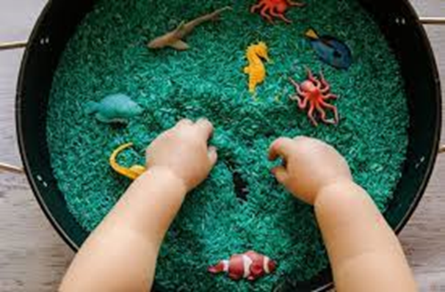
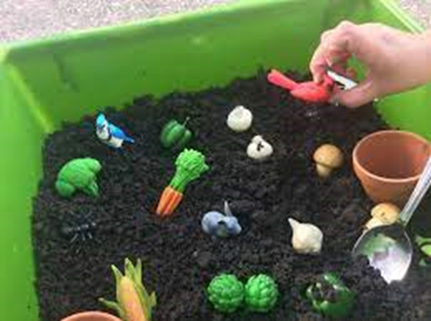
Exploring the Importance of Sensory Play in the Classroom
Hannah Oelke, Makenzie Hauger, Sarah Beack, Morgan Stark
School of Teaching and Learning, Minnesota State University Moorhead, 1104 7th Avenue South, Moorhead, MN 56563
4
Section Title: Sensory play
This poster is going to discuss the importance of play and dive deeply into sensory play. Sensory play is a crucial aspect of childhood development. Sensory play allows children to explore and engage with the environment through their senses. Sensory play helps children build cognitive skills, fine and gross motor skills, language skills, social and emotional skills, and problem-solving skills. Sensory play also supports special education and students with sensory processing disorders by providing therapeutic benefits. Overall, sensory play is an essential component of a child's development and should be an essential tool that is prioritized in classrooms.
Domain enhanced through sensory play: (2)
Motor Skills (Fine/ Gross motor)
Social and Emotional
Cognitive
Language and communication
Fine Motor (2)
Hand-eye coordination
Stretching muscles in hands and fingers
Having children explore small sensory items such as threading beads onto string, playing with measuring cups, play doh, and more supports their growth of fine motor skills and this helps with strengthening their hands and being able to hold pencils and start writing.
Gross Motor (2)
Stretching legs, arms, and large muscles
Whole body coordination
Spatial awareness
Gross motor activity's strengthen large muscles, and this give children more control over their body. Some ways you can add this into your day is outdoor nature walks, jumping, throwing balls, balancing activity's.
Social and Emotional (2)
Opportunity to self-regulate by playing with calming sensory tools
Self-expression
Empathy and opportunity for different perspectives
Providing sensory tools can help children manage their feelings and emotion. Certain tools can help calm down and relax your body.
Cognitive development (1,2)
Exploration and Inquiry
Problem solving
Conceptual understanding
Cognitive growth is enhanced by asking questions about how something works, learning cause and effect, practicing problem solving skills and analyzing materials and their functions.
Language and Communication (2)
Vocabulary Development
Social interactions
Storytelling opportunities
Language and communication can be built threw sensory play. One way we can do this is by listening to music. Music can help children learn new vocabulary words and help their moods and build coordination.
Special Education
Sensory Play serves great importance for children in special education. Children with special needs are often unable to effectively process sensory stimuli without feeling overwhelmed. This is especially true for children with sensory processing disorders- this is common in ADHD, ASD and Downs Syndrome.
The Benefits:
Cognitive: allows children in special education to naturally develop these cognitive skills by interacting with different textures, shapes, and colors.
Emotional: therapeutic and calming benefits when the right stimuli are used
Social: sensory play promotes collaborative play with peers and encourages them to seek outside of their comfort zone on their own terms.
Motor Skills: sensory play facilitates fine motor development as certain materials and components need to be manipulated, maneuvered or moved. This also has the benefit of strengthening their refined muscles.
Standard and Objective:
Sensory activities provide an exceptional number of opportunities to create a sensory experience that is both multimodal and interdisciplinary.
How to Know if Children Meet the Objective:
•Engagement
•Experimentation
•Communications
•Problem Solving
•Social Interactions
•Creativity
•Fine and Gross motor
By observing and assessing children's behaviors and interactions during sensory play, teachers can gain valuable insight into future planning and adjustments to support children's continued learning and development
Conclusions
Sensory play holds an important place in classrooms, provides ample opportunities for growth of skills across all disciplines, and supports development in the brain, language, motor skills, social, emotional, problem solving-skills, curiosity, and imagination.
Description
Creating a sensory play experience offers a substantial amount of creativity and personal preference.
Commonly used materials include:
•Sand
•Small toys
•Play-Doh
•Pom Poms
•Soil
•Water
References:
1.Butcher, K., & Pletcher, J. (2016, December 15). Cognitive development and sensory play. Michigan State University Extension. Retrieved from
2.Cleveland Clinic. (2023, December 11). What Is Sensory Play? The Benefits For Your Child and Sensory Play Ideas
3.Morgante, J. D. (2010). Title of the dissertation [Doctoral dissertation, University of Massachusetts Amherst]
4.Stacy. (2023, May 17). Benefits of sensory play for special needs. Creating Compassionate Kids
5. Google Photos, Google
5
5
Student Role
In sensory play, students actively explore materials using their senses, communicate with peers, and collaborate in play. They engage in hands-on experimentation, manipulating objects, feeling textures, and observing changes, all while interacting with peers and sharing discoveries.
•Exploration and investigation
•Respond and engage with prompted questions
•Engage and collaborate with classmates
Sensory play Ideas and activities : (2)
Sensory bin
Finger painting
Playing outside
Bath time
Listening to music
Teacher Role
•Environmental design
•Observation and assessment
•Integration to curriculum
•Promoting Social interaction
•Ask questions that provide opportunity for deep learning
•Communicate rules, expectations and guidelines for sensory play
In sensory play, the teacher serves as a facilitator, observer, and responsive guide, creating a supportive environment where children can explore and learn through their senses. Ensuring safety, the teacher monitors the play environment and educates children on responsible behavior.
Skills developed in sensory play: (1,2)
-Promotes independent thinking
-Helps kids understand cause and effect
-Helps develop problem-solving skills
-Encourages the development of fine motor and gross motor skills
-Builds cognitive skills
-Promotes language development
-Encourages creativity and explorations
-Supports emotional regulation
Evaluate this poster
Presentation ID: 9501
Scan the QR Code or go to:
https://bit.ly/sac2024-eval

