Slide 1
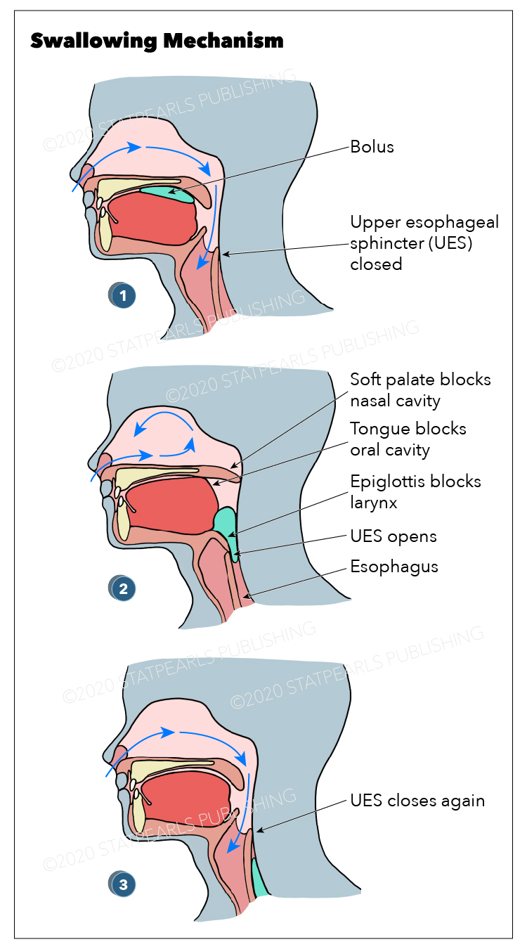
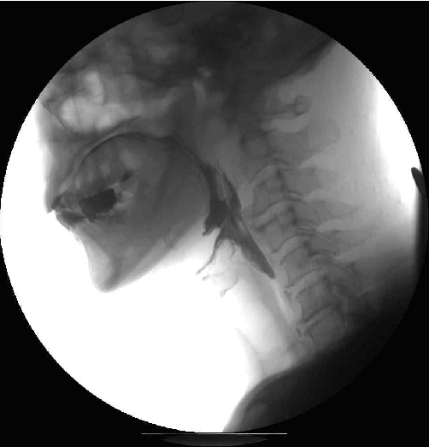
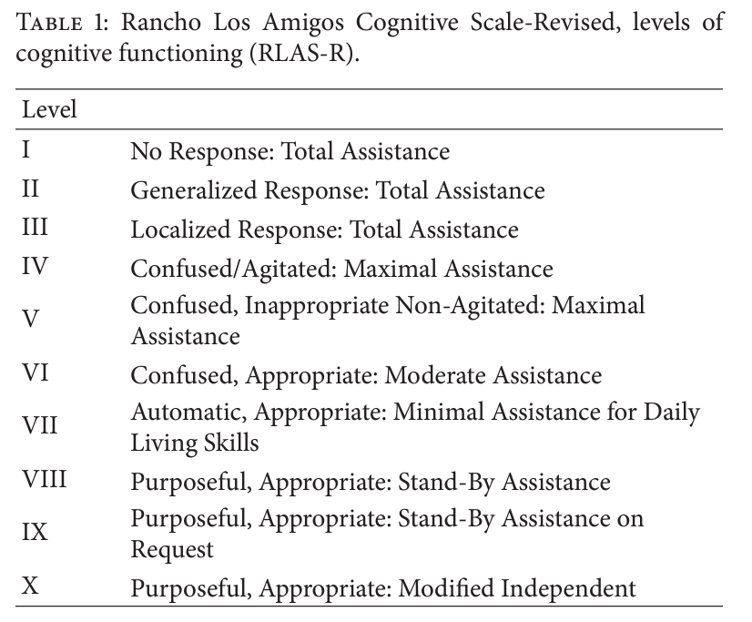
The Impact of Cognition on Dysphagia in Adults with Severe Traumatic Brain Injury
Elizabeth McDonald B.S. Graduate Student, Supervised by Sarah Ring M.S. CCC-SLP
Speech-Language Pathology, Minnesota State University Moorhead
Dysphagia Statistics
All types of dysphagia lead to an increase in morbidity & mortality (Alhashemi, 2010)
38-65% of all TBI cases result in dysphagia (Terré & Mearin, 2009)
Up to 93% of individuals with severe TBI experience dysphagia (Hansen et al., 2008)
Up to 41% of individuals with severe TBI experience silent aspiration (Terré & Mearin, 2007)
There is very limited research that specifically examines dysphagia in patients with TBIs (Howle et al., 2014)
Cognition in Swallowing
Normal Swallowing in Healthy Young Adults
Dodderi et al., 2018
Participant’s performed swallow tasks, cogitative tasks, & dual tasks
Dual tasks lead to: decreased volume swallowed, increased time per swallow, reduced swallow capacitary, slower cognitive reactions
Muhle et al., 2020
Participant’s performed swallow tasks, cogitative dual tasks, & motor dual tasks
Dual tasks lead to: premature bolus spillage, penetration and aspiration, & pharyngeal residue
Consciousness in Swallowing
Mélotte et al., 2021
Examined disorders of consciousness (DOC): unresponsive wakefulness syndrome (UWS) & minimally conscious state (MCS)
Participants who were more conscious (MSC state) were able to better manage spontaneous swallows, demonstrated a cough reflex, & greater efficiency of the oral phase
Mild Cognitive Impairment
Wang et al., 2022
Identified correlation between MCI & increased oral transit times
More significant dysphagia presentation with more severe MCI
Analysis
Cognition plays a vital role in swallowing
Limited studies have come to the same conclusion – RLAS-R is the is the best predictor of the presence, severity, and resolution of dysphagia (Hansen et al., 2008; Terré & Mearin, 2007; Terré & Mearin, 2009)
SLPs need to understand the interconnectedness of these 2 disorders
Patients with severe TBI are at an increased risk of dysphagia which could lead to malnutrition, dehydration, respiratory infections, & death (Alhashemi, 2010; Hansen et al., 2008)
Must be treated simultaneously
There are many factors to keep in mind when working with patients with severe TBI, most importantly the role that cognition plays in dysphagia
Normal Swallow
Oral Phase
Oral Prep
Prepare a bolus to swallow
Oral Propulsion
Move the bolus through the oral cavity
Pharyngeal Phase
Nasopharynx closure
Airway protection
Vocal folds
False vocal folds
Epiglottic inversion
Larynx & hyoid bone move superiorly & anteriorly
Peristaltic wave contractions
UES opens
Esophageal Phase
Bolus moved through the esophagus via peristalsis waves
References
Alhashemi, H. H. (2010). Dysphagia in severe traumatic brain injury. Neurosciences (Riyadh), 15(4), 231-236.
American Speech-Language-Hearing Association. (n.d.-a). Practice Policy: Scope of Practice in Speech-Language Pathology. Retrieved August 23, 2023. https://www.asha.org/policy/sp2016-00343/
American Speech-Language-Hearing Association. (n.d.-b). Practice Portal: Traumatic Brin Injury in Adults. Retrieved August 21, 2023. https://www.asha.org/practice-portal/clinical-topics/traumatic-brain-injury-in-adults/
ASHA Marketing Solutions (n.d.). ASHA Area of Expertise Definitions. Retrieved August 21, 2023. https://marketing.asha.org/all-opportunities/mailing-lists/area-of-expertise-definitions/
Bremare, A., Rapin, A., Veber, B., Beuret-Blanquart, F., & Verin, E. (2016). Swallowing disorders in severe brain injury in the arousal phase. Dysphagia, 31, 511-520. DOI 10.1007/s00455-016-9707-9
Cambridge Cognition. (2015, August 19). What is cognition? https://cambridgecognition.com/what-is-cognition/
Dodderi, T., Philip, N. E., & Mutum, K. (2018). Effects of a dual swallow-attention task on swallow and cognitive performance measures. Perceptual and Motor Skills, 125(1), 109-125. DOI: 10.1177/0031512517742283
Hansen, T. S., Engberg, A. W., & Larsen, K. (2008). Functional oral intake and time to reach unrestricted dieting for patients with traumatic brain injury. Archives of Physical Medicine and Rehabilitation, 89, 1556-1562. https://doi.org/10.1016/j.apmr.2007.11.063
Howle, A. A., Baguley, I. J., Brown, L. (2014). Management of dysphagia following traumatic brain injury. Current Physical Medicine and Rehabilitation Reports, 2, 219-230. DOI: DOI 10.1007/s40141-014-0064-z
Lin, K. & Wroten, M. (2022). Rancho Los Amigos. StatPearls.
Mélotte, E., Maudoux, A., Delhalle, S., Lagier, A., Thibaut, A., Aubinet, C., Kaux, J.-F., Vanhaudenhuyse, A., Ledoux, D., Laureys, S., Gosseries, O. (2021). Swallowing in individuals with disorders of consciousness: A cohort study. Annals of Physical and Rehabilitation Medicine, 64(101403), 1-7. https://doi.org/10.1016/j.rehab.2020.04.008
Mélotte, E., Maudoux, A., Panda, R., Kaux, J.-F, Lagier, A., Herr, Roxanne, Belorgeot, M., Laureys, S., & Gosseries, O. (2023). Links between swallowing and consciousness: narrative review. Dysphagia, 38, 42-64. https://doi.org/10.1007/s00455-022-10452-2
Memorial Hermann. (n.d.). Disorders of consciousness (DoC). https://memorialhermann.org/services/treatments/disorders-of-consciousness-rehabilitation#:~:text=A%20disorder%20of%20consciousness%20is,or%20a%20minimally%20conscious%20state.
Muhle, P., Claus, I., Labeit, B., Ogawa, M., Dziewas, R., Suntrup-Krueger, S., & Warnecke, T. (2020). Effects of cognitive and motor dual-tasks on oropharyngeal swallowing assessed with FES in healthy individuals. Scientific Reports, 10(20403). https://doi.org/10.1038/s41598-020-77421-3
Panara, K., Ahangar, E. R., & Padlia, D. (2023). Physiology, Swallowing. StatPearls.
Terré, R. & Mearin, F. (2009). Evolution of tracheal aspiration in severe traumatic brain injury-related oropharyngeal dysphagia: 1-year longitudinal follow-up study. Neurogastroenterology and Motility, 21, 361-369. https://doi.org/10.1111/j.1365-2982.2008.01208.x
Terré, R. & Mearin, F. (2007). Prospective evaluation of oro-pharyngeal dysphagia after severe traumatic brain injury. Brain Injury, 21, 1411-1417, https://doi.org/10.1080/02699050701785096
Wang J., Yang, C., Wei, X., Zhang, M., Dai, M., Huang, G., Huang, W., Wen, H., Dou, Z. (2022). Videofluoroscopic swallowing study features and resting-state functional MRI brain activity for assessing swallowing differences in patients with mild cognitive impairment and risk of dysphagia. Dysphagia, 38, 236-246. https://doi.org/10.1007/s00455-022-10460-2
Ward, E., Green, K., & Morton, A., L. (2007). Patterns and predictors of swallowing resolution following adult traumatic brain injury. The Journal of Head Trauma Rehabilitation, 22(3), 184-191. https://doi.org/10.1097/01.HTR.0000271119.96780.f5
Wieseke, A., Bantz, D., Siktberg, L., & Dillard, N. (2008). Assessment and early diagnosis of dysphagia. Geriatric nursing, 29(6), 376–383. https://doi.org/10.1016/j.gerinurse.2007.12.001
Wortzel, H. S. & Arciniegas, D. B. (2012). Treatment of post-traumatic cognitive impairments. Current treatment options in neurology, 14(5), 493–508. https://doi.org/10.1007/s11940-012-0193-6
Cognition in Swallowing with Severe TBI
Very few studies specifically look at the role of cognition in swallowing in adults with severe TBI
General consensus – the more severe the TBI, the more severe the dysphagia presentation (Hansen et al., 2008; Mélotte et al., 2023)
The Rancho Los Amigos Revised Scale (RLAS-R) has consistently been found to be the best:
Predictor of the presence of dysphagia
Predictor of the severity of dysphagia
Predictor of the resolution of dysphagia
(Terré & Mearin, 2007; Terré & Mearin, 2009; Hansen et al., 2008)
There is an identified relationship between the severity of a TBI, as measured with a cognitive tool, and the severity of dysphagia, as measured by outcomes.
(Panara et al., 2023)
Dysphagia Presentation in Severe TBI
Examined via videofluoroscopic swallowing study (VFSS)
Oral Phase Dysfunctions
Impaired tongue control (predominant)
Increased oral transit time
Piecemeal deglutition
Dysfunction in palatoglossal closure
Pharyngeal Phase Dysfunctions
Aspiration (predominant)
Residue in pyriform sinuses
Impairment of the UES
Pharyngeal delay
Penetration into laryngeal vestibule
Evaluate this poster
Presentation ID: 9558
Scan the QR Code or go to:
https://bit.ly/sac2024-eval
(Terré & Mearin, 2007)
(Eun, S. J., Kim, S. G., & Hong, J. R., 2010)
(Stenberg et al., 2015)

