Slide 1
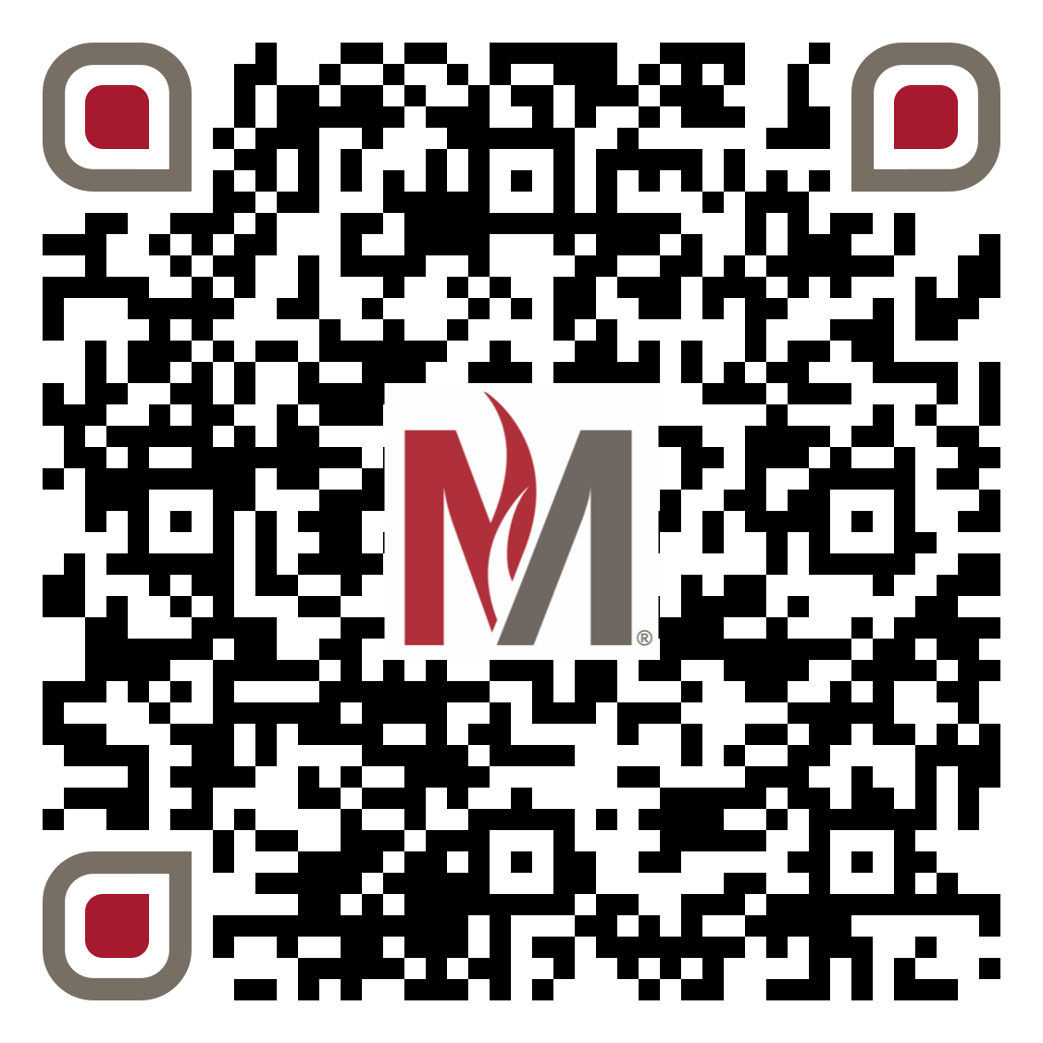
Anxious, Ambivalent, & Biased?:
Does Attachment to a Mother Figure Predict Ambivalent Sexism?
Kylie S. Nay, Arina D. Bratamidjaja, Hailey B. Hupke, & Olivia D. Goderis (Faculty Advisor: Dr. Jenna N. Laurin)
Psychology Department, Minnesota State University Moorhead, 1104 7th Avenue South, Moorhead, MN 56563
Introduction:
Gender Identity | n | Percentage
Cisgender Women | 67 | 72.83%
Cisgender Men | 13 | 14.13%
Non-binary/Third Gender | 8 | 8.70%
Discussion:
- Few past studies which have indicated a connection between romantic attachment styles and sexism (Bommel et al., 2014; Bustos, 2020; Hart et al., 2012), but there have not been many discussions on how it relates to childhood attachment style and parental, rather than romantic, attachment.
- Bommel, Sheehy, and Ruscher (2014) found that women who have a high insecure attachment style did not recognize blatant sexism, but were very aware when exposed to ambiguous sexism.
- Attachment style might partially explain women’s divergent response to sexism (Bommel et al., 2014; Bustos, 2020; Hart et al., 2012).
- Men with an anxious attachment style are likely to hold benevolent sexism attitudes compared to men with an avoidant attachment style (Hart et al., 2012).
- Fathers were shown to have higher hostile sexism attitudes compared to mothers, while it was shown that mother’s level of sexism is connected with their education level (Lipowska et al., 2016).
- The role of sexism in shaping the attitude of mothers towards sons is the most prominent (Lipowska et al., 2016).
- The current study expanded past research by examining the influence of childhood attachment style on the endorsement of sexist attitudes among college students.
It is evident that there is a correlation between the attachment style to one’s caregiver and endorsement of ambivalent sexism.
It is shown that those who had an anxious attachment style towards their caregivers throughout childhood express feelings of benevolent and hostile sexism. Whereas those who had an avoidant attachment style endorsed higher attitudes of benevolent sexism, but not hostile sexism.
The limitations of the current study include the lack of prior research studies on the topic during data collection, which in turn, leads to the lack of available or reliable data.
Our limited sample is due to the population from which the data was collected. If the sample was expanded to include different departments who are a part of Minnesota State University Moorhead, it may have allowed for differing results.
For future studies, it may be helpful to use a larger sample size, and to expand the demographic search for participants.
It was expected that there would be a relationship between attachment style to one’s caregiver and the endorsement of ambivalent sexism. This hypothesis was supported through our survey’s results. Overall, the important finding from the statistical analysis was that people who have an anxious attachment style for their caregiver during childhood are likely to hold both benevolent and hostile sexist attitudes, while people who have an avoidant attachment to their caregivers are likely to hold benevolent sexist attitudes but not hostile sexist attitudes.
Results:
The regression analysis showed a significant main effect for anxiety attachment style and benevolent sexism, F(1,89)= 8.20, p= .005, and a significant main effect for hostile sexism, F(1,89)= 12.06, p < .001
The regression analysis showed a significant main effect for avoidant attachment style and benevolent sexism, F(1,89)= 5.62, p= .020, and a non-significant main effect for hostile sexism, F(1,89)= .186, p = .667
Avoidant Attachment Style
Methods:
Participants:
- The study included 92 Minnesota State University Moorhead undergraduate psychology students.
- The study was presented online, using the Qualtrics program
- Compensation was given in the form of extra credit points in academic classes.
At the outset of the survey, participants were asked to complete four demographic questions (age, gender identity, race, and religious affiliation).
Age:
Range = 18-49
Mode = 19
Mean = 21.64
Design:
- Independent variable:
- Attachment style toward female figure
Dependent variable:
-Ambivalent sexist attitude
Materials:
-The survey consisted of 51 questions compiled from three assessment tools (ECR-RS, ASPA-SF, and ASI)
- The Adult Scale of Parental Attachment-Short Form (ASPA-SF) and the Relationship Structures Questionnaire (ECR-RS)
- Used to determine the attachment style towards the caregivers in their life.
- On a scale 1-5 (1 being never, 5 being constantly)
- Ex)I had a mother with me when I was upset, I enjoyed taking care of my mother, I talked things over with my mother.
- The Ambivalent Sexism Index (ASI)
- Used to measure hostile and benevolent sexist attitudes.
- On a scale of 1-5 (1 being never, 5 being always)
Ex) I talk things over with this person, I often worry that this person doesn’t really care for me, I’m afraid this person may abandon me.
p =.020*
p =.667
Benevolent Sexism
Hostile Sexism
References:
Bommel, T., V., Sheehy, A., Ruscher, J. B. (2015). The role of attachment style in women’s recognition of sexism.
Personality and Individual Differences, 74, 235-240.
Bustos, J. C. (2020). An investigation of sexism in relation to self-esteem and attachment style [Unpublished master’s
thesis]. California State University, Chico.
Hart, J., Hung, J., A., Glock, P., & Dinero, R., E. (2012). He lovers her, he loves her not: attachment style as a
personality antecedent to men’s ambivalent sexism. Personality and Social Psychology Bulletin, 38(11), 1495-1505
Lipowska, M., Lipowski, M., & Pawlicka, P. (2016). “Daughter and son: a completely different story”? Gender as a
moderator of the relationship between sexism and parental attitudes. Health Psychology Report, 4(3), 224- 236.
Anxious Attachment style
p =.005*
p < .001*
Benevolent Sexism
Hostile Sexism
Contact:
Questions can be directed to jenna.laurin@mnstate.edu, in addition to kylie.nay@go.mnstate.edu, arina.bratamidjaja@go.mnstate.edu hailey.hupke@go.mnstate.edu, olivia.goderis@go.mnstate.edu
Evaluate this poster
Presentation ID: 9480
Scan the QR Code or go to: https://bit.ly/sac2024-eval

