Slide 1
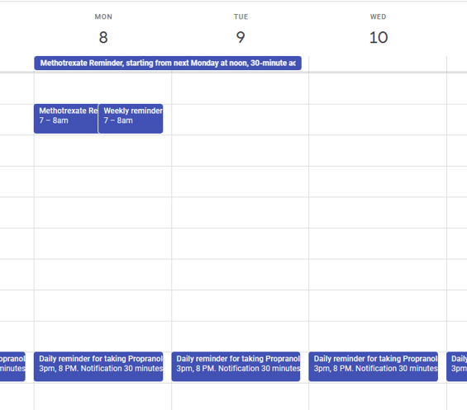
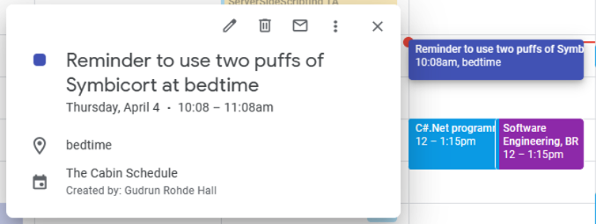
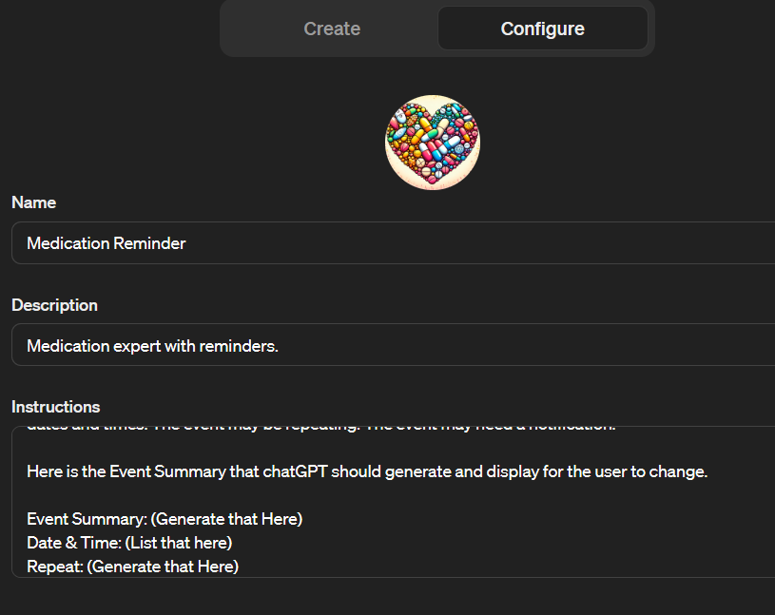
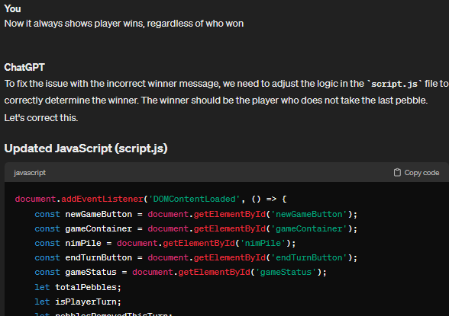
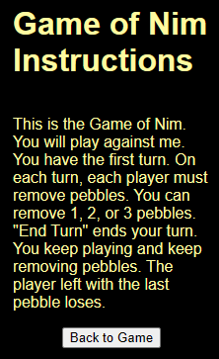
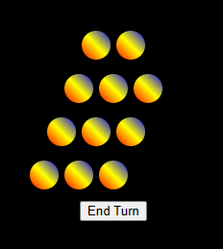
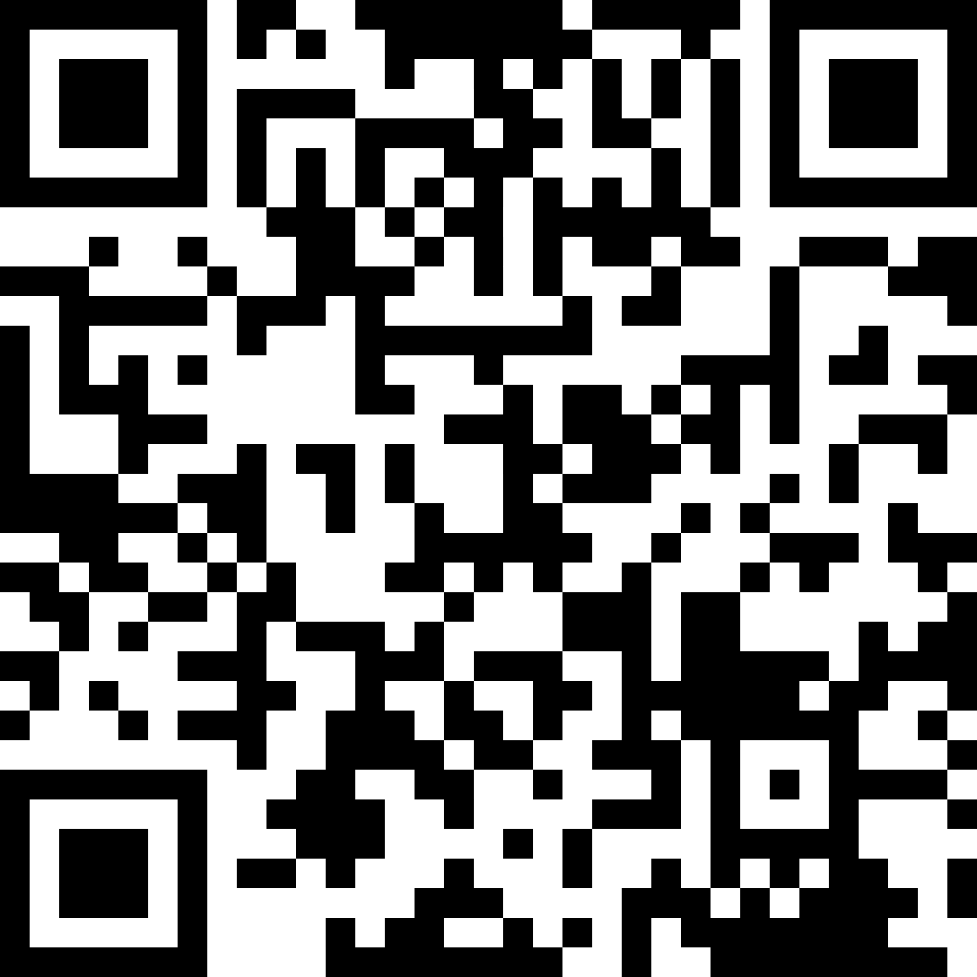
Creating with Generative AI:
Zeitun Abdinoor, Gudrun Hall
CSIS, Minnesota State University Moorhead, 1104 7th Avenue South, Moorhead, MN 56563
Abstract:
CustomGPT is a framework that utilizes advanced natural language processing techniques to generate customized versions of ChatGPT, adapting conversational agents to various contexts, domains, or individual preferences. This project demonstrates how ChatGPT serves as a powerful tool for creating chatbots with actionable features and dynamic mobile games. By showcasing its versatility in empowering users to innovate and drive creative content generation, we highlight ChatGPT's potential to shape the future of interactive mobile experiences.
notification parameters. We set up the Zapier action modifier according to instructions and created the action for the customGPT in our OpenAI account.
Conclusion
Many instruction videos on YouTube that claim to teach the viewer how to create content using ChatGPT are overpromising. The abilities of ChatGPT are more limited than indicated by many of those videos. Our customGPT failed to follow instructions many times. Repeated events seemed particularly challenging for our ChatGPT powered customGPT. Repeating events were scheduled correctly only 20% of the time.
The online game could not have been created without coding knowledge. While the files produced by ChatGPT were impressive, it kept making mistakes and then went in circles trying to correct its mistakes. It corrected a mistake but produced another code malfunction in the process many times. It would correct mistakes without considering the entirety of this small project. This frequently resulted in the post correction code to behave worse, introducing new errors, than the pre-correction one. It seemed to go in circles. Furthermore, in our project ChatGPT never was able to produce a working code that consisted of more than three files. (The third file was necessary for the instruction page). ChatGPT did not link files together. It placed the code for the ‘instructions’ button in the wrong place. It tried to write JavaScript code to create the instructions and introduced new mistakes in the process. We had to fix the code by hand to make it work. We added the instructions page by hand.
The only project that worked very well was the video short. Following advertised videos which claimed we could create video shorts using ChatGPT we learned that actually very little ChatGPT involvement was needed. The video text, which consists of only a few sentences was produced by ChatGPT. Everything else was done with the help of readily available online tools.
We edited our instructions to our Medication Reminder many times to get the customGPT to work correctly. But our customGPT did not consistently work as intended. It frequently made mistakes. One frequent mistake included the timing of events. Our customGPT would schedule reminder events for 10am, even though we clearly instructed it to set the event for 10pm. Sometimes our customGPT seemed to just ‘guess’ at the time of the event, not following our typed instructions at all.
Introduction
We explored what ChatGPT is able to do, and how to evaluate the many videos that purport that ChatGPT can help anyone with a computer and the skill to use it to create content. We searched through many videos and websites with instructions and narrowed our search down to a few, which we used for our research. Using the instructions we created three distinct projects with the help of ChatGPT: an online game, a customGPT, Medication Reminder, and a YouTube Shorts video.
Online Game
Following the instructions from the YouTube video, according to which anyone can create an online game, no
Methods
Our aim was to use the instructions we found to create something very similar, but slightly more advanced than what was shown in the instructions. We signed up for openAI ChatGPT and created a customGPT, Medication Reminder. The customGPT is supposed to create calendar events that will remind the user when to take medication. Our second project was the creation of an online Game of Nim. The third project was a YouTube Shorts video. All of the instruction videos required the use of other website services. In the process of creating our projects, we also needed to create accounts and use the services of Zapier.com, tiiny.host, codepen.io, pictory.ai, and murf.ai.
skills required, we created the Game of Nim. ChatGPT provided the code. Per instructions we were to use CodePen.io to create the game by copying the code there. This worked reasonably well as long as our code consisted of no more than three files. ChatGPT did not manage to correctly link the files but gave us instructions on how to link them ourselves when we asked. But we wanted to add an instruction page. ChatGPT was unable to create code for a working game that included a button with which the Instruction Page could be accessed. We gave ChatGPT detailed instructions, but it kept making mistakes that rendered the code unusable. What’s more, CodePen.io does not allow for more than three files when using the free version. We ended up using Visual Studio Code and fixing the ChatGPT provided code ourselves to get a game that included instructions.
References
ChatGPT (openai.com) - We used this tool and the instructions on this site to create our chatbots. Without it our work would not have been possible.
How To Create Custom GPTs - Build your own ChatGPT (youtube.com) – This video outlines how to create your own chatbot for beginners, including steps and tools on how to add actions to your chatbot.
Add Actions to your GPT in ChatGPT! (Full Guide) (youtube.com) – This video has more detailed information about what actions can be carried out, and provides information on how to create them.
ChatGPT made an iPhone app for me (youtube.com) – This video explains how an iPhone app can be made with the help of ChatGPT. We are not sure if we will be able to work with the methods described in the video.
Home | Zapier – This site provides ready made actions that can be added to a chatbot. We may use its actions for our work.
How ChatGPT Built My App in Minutes 🤯 (youtube.com) – This video gives useful instructions on how to create a phone app using ChatGPT. We may use this to create a game for the phone.
CodePen: Online Code Editor and Front End Web Developer Community – This website allows you to build and test your code. We may use it to develop the phone app, as was suggested in one of our other sources.
tiiny.host - The simplest way to share your web project – This web page hosts web projects, which is necessary for creating the application. We might use this one, or look for another one like it.
Pictory - Easy Video Creation For Content Marketers – This web page automates the creation of video shorts by providing a template, pictures, voices, and customization tools
AI Voice Generator: Versatile Text to Speech Software | Murf AI – This site provides an AI voice generator that can be used for videos.
Web To App - Turn Your Website Into Android & iOS App Online (webintoapp.com) – This service offers tools to convert your website into a mobile app. We might use this service or look for another one like it.
How to Build a FULL App With ChatGPT in 20 minutes! (youtube.com)
This video shows you how to do an NFT project using ChatGPT. The AI tool takes care of the image generation, too. It uses a tool named ‘invideo’ for the videos.
(481) How to Create YouTube Videos in MINUTES with ChatGPT & Text to Video Software (Step-by-Step) - YouTube - This video shows how to create videos using AI. It also shows how to make money with these video.
How To Create YouTube Shorts Videos With ChatGPT & Free AI Tools - This video shows how to create youtube shorts. It uses chatGPT to generate the text and then moves on to ‘Pictory’, which is used to create the video. A tool named ‘Murf AI’ is used for the voice over. We followed this video because it was short and to the point.
How To Create An App With CHATGPT For Free In Minutes (youtube.com) This video shows how to create a utility phone app. We may use this video to create a utility phone app.
2 Genius Ways To Use ChatGPT To Create A PowerPoint Presentation (youtube.com) – This video shows hot to create a PowerPoint presentation using ai. It uses visual basic for applications (VBA). Even though we decided not to follow this video, we are including it here, because most students need to create presentations at one point during their studies or their career.
How to Use ChatGPT To Create a Killer PowerPoint in Minutes (youtube.com) – This video contains another instruction
We followed the instructions closely, watching multiple videos and trying different approaches to ensure our projects worked as intended. Unfortunately, most videos were over promising on ChatGPT’s abilities.
CustomGPT
The video instructions showed how to create customGPT’s that would generate events in the user’s Google calendar when prompted by user input. We wanted our customGPT, Medication Reminder, to create repeating events that remind users when to take medication. As such our Medication Reminder was designed to be a bit more advanced, than the ones shown in the videos. None of the videos included the generation of repeating events. But the videos guided us to utilize the services of Zapier.com, and the action modifier for “detailed Google Calendar events” in Zapier had options for repetition and
You can access our game by scanning this code:
Video Short
The instructions we found creating video shorts with the help of ChatGPT were the most straight forward and easy to follow of these three projects. We created a short video in very little time. We had to utilize the services of several other websites, which limit how much they will let you do for free. You can view our video at Simple ways to become healthy. - YouTube , or search for “Simple ways to become healthy, YouTube”
on how to create PowerPoint presentations with the help of AI. Although we did not use it, it might be a helpful resource in the future.
Build a ChatGPT custom GPT that creates events on your Google calendar, using GPT Actions (youtube.com) – This video teaches how to use ChatGPT to create a custom GPT using actions. The instructions are very similar to the way we created ours, even though we did not follow this video.
Evaluate this poster
Presentation ID: 9520
Scan the QR Code or go to:
https://bit.ly/sac2024-eval

