Slide 1
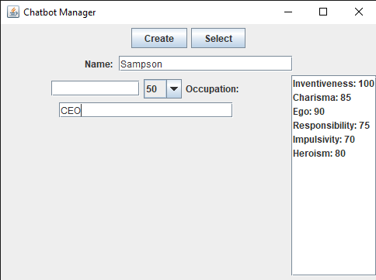
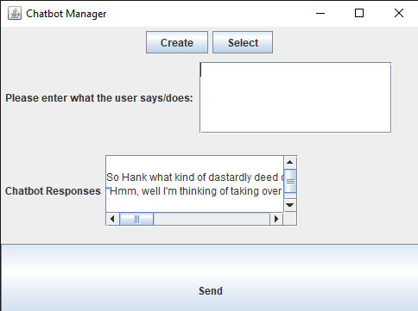
Assigning a Dynamic Personality to Artificial Intelligence:
It is possible to give an artificial intelligence a dynamic personality
Austin Jeral
Computer Science and Information Systems
Method
v
Creation
User input
Personality Tests
v
:
78
Database tables
Code that enables self updating
v
v
Take a picture to evaluate this poster or go to
bit.ly/sac2024-eval
Presentation ID: 9526

