Slide 1
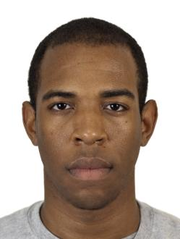
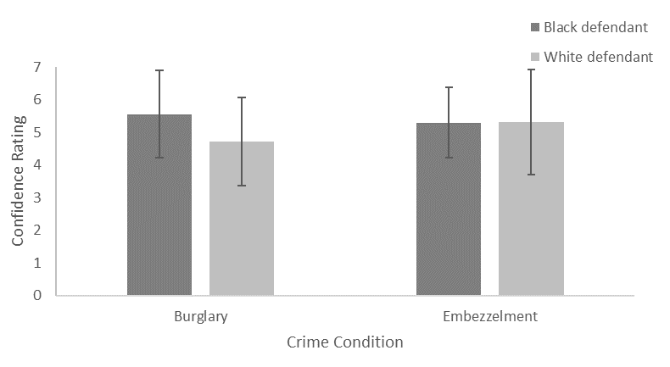
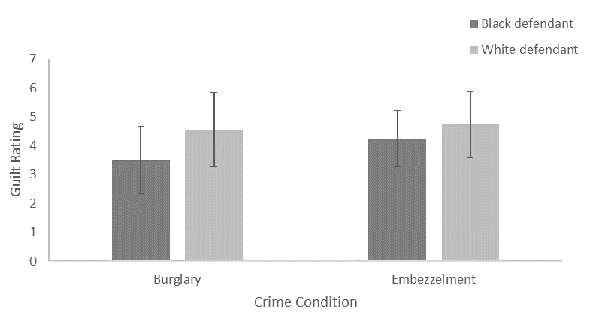
Do Perceptions of Guilt Vary as a Function of
Defendant Race and Crime Type? A Mock Crime Experiment
Elizabeth Murken, Rochelle Bergstrom
Psychology Department, Minnesota State University Moorhead, 1104 7th Avenue South, Moorhead, MN 56563
Introduction:
Much past research has studied racial discrimination in the criminal justice system. Past research in 1983 by Sunnafrank and Fontes studied facial images and crimes and matched faces and crimes to correlate stereotypical crimes.
Later research in 2003 by Jones and Kaplan furthered this research by comparing stereotypical crimes and non-stereotypical crimes. This study furthers Jones and Kaplan’s study by comparing different stereotypical crimes for the black defendant and not comparing a non-stereotypical crime.
Crime Stimuli:
Results: Confidence
No Main Effect of Race
F(1,71)= 1.70, p>.05
No Main Effect of Crime Type
F(1,71)= 0.29, p>.05
No Main Effect for Crime x Race Interaction
F(1,71)= 1.84, p>.05
Results: Guilt
Main Effect of Race
F(1,71)= 8.55, p<.05, η²= 0.11
Marginally Significant Crime Type
F(1,71)= 3.12, p>.05
No Main Effect for Crime x Race Interaction
F(1,71)=1.16, p>.05
Jamal Henry, 28 years old, was arrested on the night of August 31, 2022. Jamal was arrested for burglary. Burglary is legally defined as entering a building or structure with the intent to commit a crime therein unless that building or structure is open to the public at the time.
At the time of the arrest, Jamal claims that he was with a friend a couple of blocks down from the house that was burglarized. At the house the only thing that was stolen was cash. Jamal’s alibi is not strong, and he is being taken to court and tried for the burglary.
The police officers said that he was fleeing from the crime
Hypotheses:
The Black defendants will be found more guilty than the White defendants.
Black > Whites
It is also expected that the participants will convict the black defendants when compared with their stereotypical crime higher than the white defendants and their stereotypical crime.
Black Burglary> White Embezzlement
The last expected outcome is the crime of burglary will have higher conviction rates than embezzlement.
Burglary> Embezzlement
when they picked up Jamal. Jamal’s defense for running away was that he was afraid of the cops and knew they would arrest him for nothing.
Jamal has a clean record and has no history of any offenses. One of Jamal’s strongest defenses is he is an upstanding citizen who does a lot for his community.
However, the officers have heard rumors that Jamal is involved in his community so that he can have an inside advantage in stealing from his community.
Figure 2
Michael Johnson, 28 years old, was arrested on the night of August 31, 2022. Michael was arrested for embezzlement. Embezzlement is legally defined as the fraudulent appropriation of property by a person to whom such property has been entrusted, or into whose hands it has lawfully come.
An example of embezzlement is Ponzi schemes, or employees destroying records and pocketing the company’s cash.
Michael was working at Vozz Industry as a corporate manager. In the last couple of years, there has been money being skimmed off their properties, most of which went missing since Michael was
Method:
75 MSUM undergraduate students aged 18-43 (M=21.05, SD=4.85).
Predominately female 82.7%, 12% male, and 5.3% other
The race was also predominately White Caucasian 82.7%, 9.3% Black,
and 8% other
2 (race- black, white) x 2 (crime- burglary, embezzlement) between subjects factorial ANOVA.
hired. Michael has opened his bank accounts to the police department to do thorough research.
Vozz Industry has decided to charge Michael and send him to court for the federal government to hold him accountable for the missing money. Michael swears that he did not take the money, but the police claim that they see some inconsistencies in Michael’s bank accounts.
Michael claims that his inconsistencies are due to a hacker that infiltrated his bank information, which prompted him to move money around his accounts. The police are continuing to investigate this claim and are finding some inconsistencies in why the money is being moved around.
Conclusion:
Whites found more guilty than blacks regardless of the crime
Burglary was found marginally more guilty than embezzlement
Strengths
Recollection Survey
Limitations
Chicago Face Database
Crime Scenarios
Procedure:
Criminal Case, Recollection Survey, Post Trial Survey, Debriefing
Figure 1
Burglary Jamal Henry
Embezzlement Michael Johnson
References:
Jones, C. S., & Kaplan, M. F. (2003). The effects of racially stereotypical crimes on juror decision-making and information-processing strategies. Basic and Applied Social Psychology,25(1),1–13. https://doi.org/10.1207/s15324834basp2501_1
Maeder, E. M., & Burdett, J. (2013). The combined effect of defendant race and alleged gang affiliation on mock juror decision-making. Psychiatry, Psychology and Law, 20(2), 188–201. https://doi.org/10.1080/13218719.2011.633330
Sunnafrank, M, & Fontes, E. N. (1983). General and crime related racial stereotypes and influence on juridic decisions. The Cornell Journal of Social Relations., 17(1), 1-15.
Evaluate this poster
Presentation ID: 9427
Scan the QR Code or go to:
https://bit.ly/sac2023-eval
Embezzlement Jamal Henry
Burglary Michael Johnson

