Slide 1
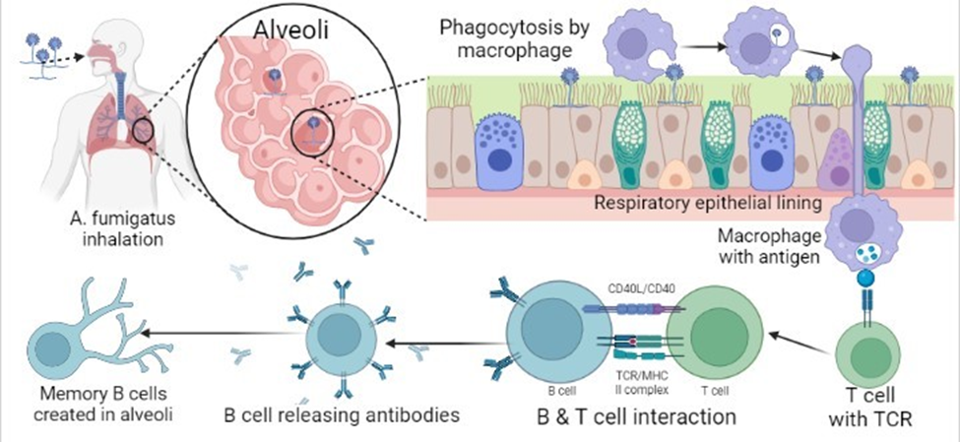
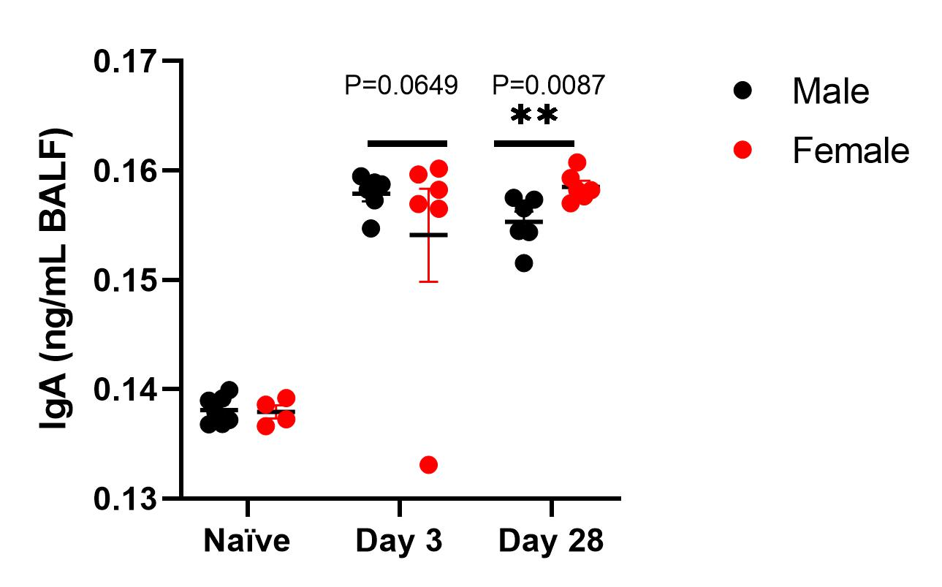
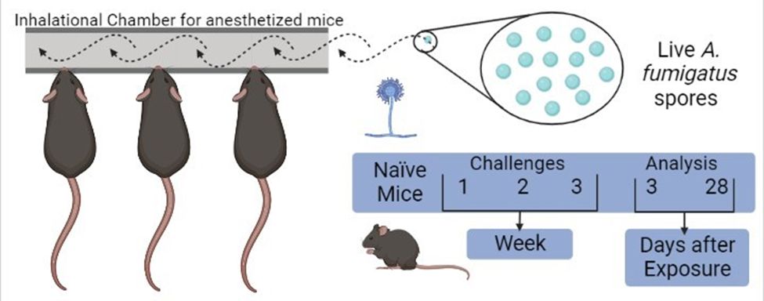
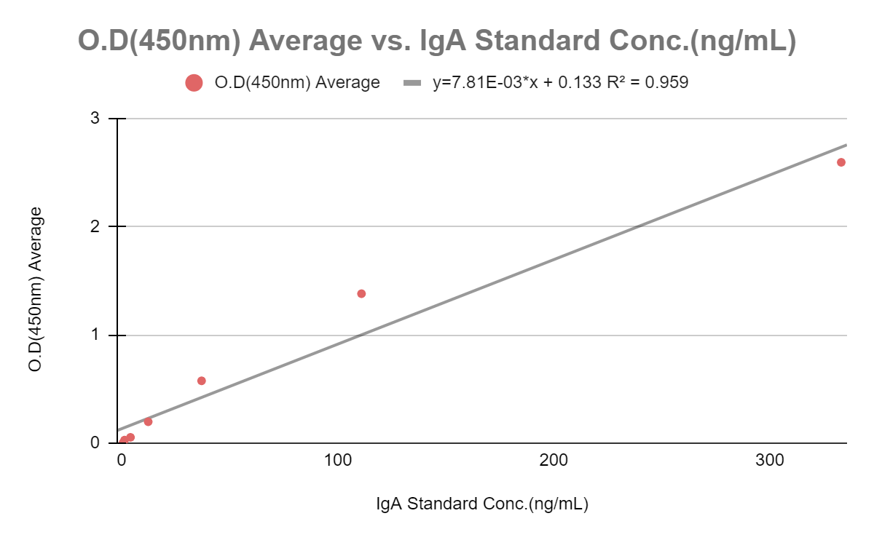
Investigating Differences in IgA Antibody Response against Aspergillus fumigatus in wild type and TLR7 protein deficient mice
Courtney Folk
Biosciences Department, Minnesota State University Moorhead, 1104 7th Avenue South, Moorhead, MN 56563
Background
Results
Discussion
A. fumigatus: fungal pathogen and allergen that is inhaled form soil, dust, and plant matter in the environment.
IgA: commonly released after a pathogen interacts with mucosal surfaces in the respiratory system (Patel & Jialal , 2022).
Sex differences: Females have higher antibody levels due to increased B cells (Yong et. al., 2021)
TLR7: an x-chromosome linked protein that when removed can decrease immune response (Xu et. al., 2021).
IgA antibody levels in Bronchoalveolar Lavage Fluid (BALF) were significantly increased after inhalational exposure to A. fumigatus on Days 3 and 28, in both male and female wild-type mice, albeit higher levels were observed in female mice on Day 28.
The respiratory system is lined with mucus. Once A. fumigatus is in the lungs, IgA, a mucosal homeostasis regulator of the immune system can be triggered (Patel & Jialal , 2022).
Females have higher levels of antibodies, which is attributed to increased number of circulating B cells (Yong et. al., 2021).
TLR7 is an x-chromosome linked protein that when removed can decrease immune response and allow for better clearance of A. fumigatus (Xu et. al., 2021).
I predict that in TLR7 knockout mice IgA levels will be lower in comparison to the control.
A B
References
Figure 1. Antibody production from exposure to inhaled A. fumigatus. Schematic drawn by Courtney Folk using www.biorender.com
Patel A, Jialal I. Biochemistry, Immunoglobulin A. [Updated 2022 May 8]. In: StatPearls [Internet]. Treasure Island (FL): StatPearls Publishing; 2023 Jan-. Available from: https://www.ncbi.nlm.nih.gov/books/NBK551516/
Xu, B., Luo, Q., Gong, Y., Li, J., & Cao, J. (2021). TLR7 Expression Aggravates Invasive Pulmonary Aspergillosis by Suppressing Anti-Aspergillus Immunity of Macrophages. Infection and immunity, 89(4), e00019-21. https://doi.org/10.1128/IAI.00019-21
Yong, Jaggi, T. K., Chan, L. L. Y., & Chotirmall, S. H. (2021). Sex Differences in Respiratory Infection. In Sex-Based Differences in Lung Physiology (pp. 365–404). Springer International Publishing. https://doi.org/10.1007/978-3-030-63549-7_13
Methods
Acknowledgements
This study was supported by Beta Beta Beta Research Foundation and Student Research Grant through the Strong Scholars Research Fund at MSUM. I would like to thank Dr. Sumali Pandey for her guidance and assistance with this analysis. I would also like to acknowledge the Microbial Pathogenesis Lab for research-related assignments. Finally, thank you to MSUM and all of those who have worked to put on the Student Academic Conference this year.
Figure 1. Experimental design. Schematic representing the A. fumigatus inhalation in mice. C57BL/6J mice of either sex that are six weeks old were anesthetized. Then, mice were taken to the inhalation chamber, laid supine, and nostrils positioned in the ports of the inhalation chamber. Air supply was hooked onto one end of the inhalation chamber to be inhaled by mice with a steady dose of eight-day-old, live, and dry A. fumigatus culture that was on Saboraud Dextrose Agar. This was repeated weekly for three weeks at ten minutes per challenge. The controls, naïve mice, will be maintained without exposure to exposed mice. For analysis, mice will be euthanized on day 3 and 28 after the last challenge. Bronchoalveolar lavage fluid (BALF) and serum will be analyzed for IgA antibodies, using ELISA. Schematics drawn by Courtney Folk using www.biorender.com
Figure 2. Immunoglobulin A titers. IgA levels (mean ± SEM) in bronchoalveolar lavage fluid (A) or serum (B) were obtained from female and male mice at Day 0 (naïve), 3, and 28 after third A. fumigatus challenge. The p-values and corresponding solid line indicate the pairwise comparisons between male and female mice using Mann-Whitney test.
Contact Information
Courtney Folk: courtney.folk@go.mnstate.edu
Evaluate this poster
Presentation ID:9293
Scan the QR Code or go to:
https://bit.ly/sac2022-eval
Figure 3. Standard curve for IgA ELISA.

