Slide 1
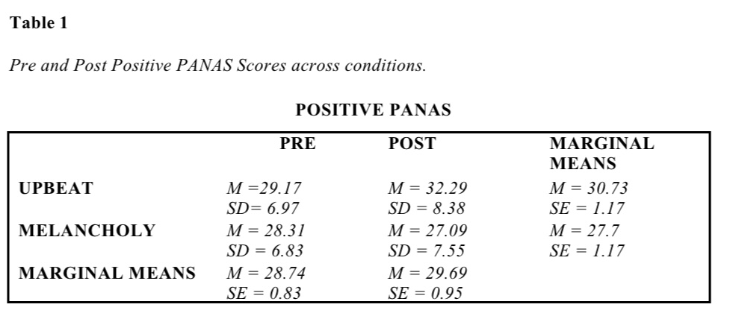
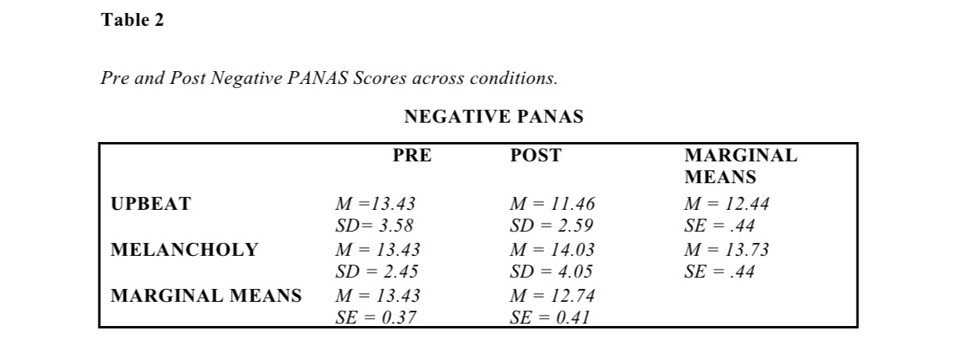
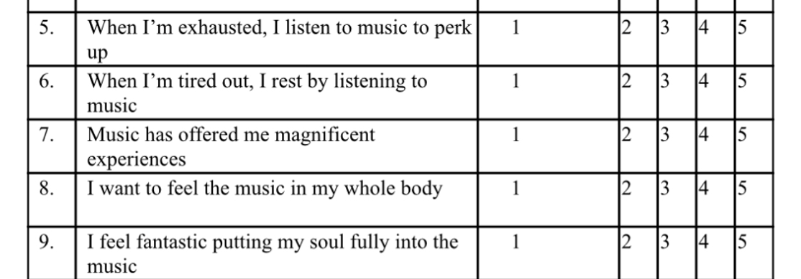
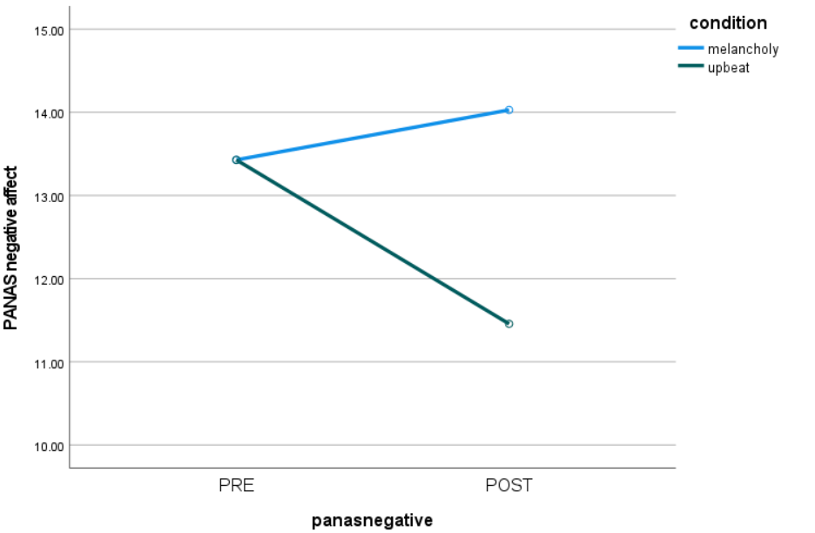
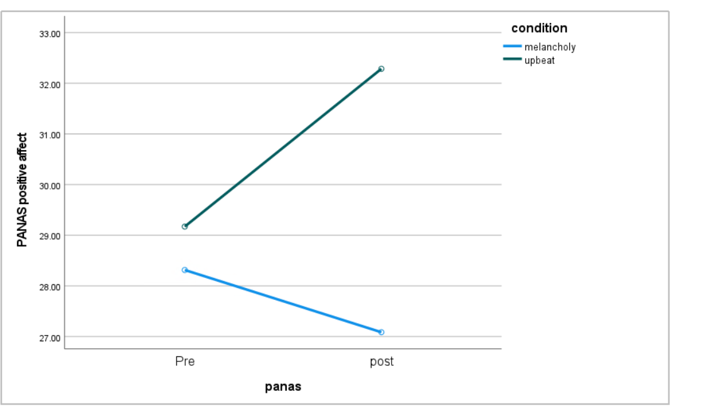
Music and Mood Regulation: The effect of upbeat music on moods
Abiola Adebayo ( Dr. Christine Malone, faculty advisor)
Psychology Department, Minnesota State University Moorhead, 1104 7th Avenue South, Moorhead, MN 56563
Background:
Research suggests that emotional regulation plays a vital role in mental and physical
health (Gross, 1998), and people who can regulate their emotions have better well-being (Cote et al., 2010). Going with this understanding, we can posit that there is a clear need for emotional regulation strategies. Music has been shown to be important in human lives not just for entertainment; it also has mood regulatory benefits (Sloboda et al., 2001, van Goethem & Sloboda, 2011).
More research has shown music to be either a maladaptive or an adaptive mood regulatory strategy and can either worsen or alleviate moods. (Garrido & Schubert, 2013, Garrido et al., 2022). Different types of music have been shown to evoke different emotions and music is an essential tool for mood regulation and different types of music create, alleviate and/or worsen different emotional states.
This research looks to explore the ways music is used for mood regulation and the general effect of music on moods. This study also examines the adaptive and maladaptive use of music for mood regulation.
Hypotheses
Listening to upbeat music will produce an increase in positive affect.
Listening to melancholy music will produce an increase in negative affect.
Procedure:
Informed consent was obtained​
PANAS & BMMR questionnaire filled.
Order was counterbalanced
Randomly assigned to music group
Listened to assigned music for approximately 10 minutes
A second PANAS was administered
Demographic Questionnaire
Debriefed​
Discussion:
The present study investigates the use of music for mood regulation, specifically exploring the adaptive and maladaptive use of music. The results showed that upbeat music had a statistically significant effect on increasing positive affect and decreasing negative affect, while melancholy music did not exhibit significant effects. However, the lack of melancholy music effect was unexpected since prior research showed that listening to sad music can increase negative affect. One possible explanation for this unexpected result is the personal relevance of music, which can greatly impact the emotional response to it.
The BMMR scale is a measure to assess ways people use music to regulate their emotions. Results from this study indicates greater use of music by participants in both groups to regulate moods. Participants in the upbeat group had slightly higher scores compared to the melancholy condition. Participants in the upbeat group specifically had much higher scores in the first subset that measures, “entertainment and happy mood maintenance”. This suggests that individuals may use music to maintain positive moods that they are already experiencing, rather than solely using it to regulate negative emotions.
The present study contributes further to existing literature on the use of music for mood regulation, demonstrating that music can effectively regulate emotions and increase positive affect. Moreover, the study indicates that it is crucial to understand which types of music can be categorized as adaptive or maladaptive based on its effects. The study findings also have implications for music therapy, which could be useful as a psychotherapeutic approach in enhancing mood states and reducing stress levels. This is not only relevant to mental health professionals but also for individuals interested in using music as a mood regulatory strategy.
The limitations of the self-report questionnaire used to assess mood states before and after listening to music should be acknowledged, and future research could address these limitations by using physiological measures to assess mood. Overall, despite its limitations, the study highlights the potential of music in mood regulation and underlines its implications for mental health professions, the music industry, and the general public as a low-cost and accessible tool to alleviate stress and enhance well-being.
In conclusion, the study suggests that music can have significant effects on regulating emotions, as upbeat music significantly increases positive affect, which can benefit those in the mental health field and individuals using music as a mood-regulatory tool. Future studies that utilize physiological measures, non-college populations, or that explore neural mechanism of music induced emotions would further enrich our understanding of the adaptive and maladaptive use of music and its effects on mood regulation.
Results:
Mean pre vs post positive PANAS scores and standard deviations for each of the treatment conditions are shown in Table 1.
Mean pre vs post negative PANAS scores and standard deviations for each of the treatment conditions are shown in Table 2.
A two-factor mixed analysis of variance was performed for positive affect
No significant main effect was found for pre vs post PANAS scores, (F(1, 68) = 1.94, p = .17, η² = 0.028)
No significant main effect was found for type of music (upbeat and melancholy) (F(1, 68) = 3.38, p = .071, η² = 0.047)
A significant interaction was found between pre vs post PANAS scores and type of music (upbeat and melancholy) (F(1, 68) = 10.28, p = .002, η² = 0.131)
Simple main effects analysis showed significantly greater positive affect after upbeat music
A two-factor mixed analysis of variance was performed for negative affect
No significant main effect was found for pre vs post PANAS scores, (F(1,68) = 2.2, p = .143, η² = 0.031)
A significant main effect was found for type of music (upbeat and melancholy), F(1,68) = 4.29, p = 0.042, η² = 0.059
A significant interaction was found between pre vs post PANAS scores and type of music (upbeat and melancholy), F(1,68) = 7.73, p = .007 η² = 0.102
Simple main effects analysis showed significantly less negative affect after upbeat music
Method:
Participants:
70 MSUM students over 18years participated in the study
42 (60%) identified as female, 25 (35.7%) as men and 3(4.3%) as non-binary.
Mean age of participants was 21.69 (SD 6.58).
All participants reported listening to music at least for 5 mins a day.
Compensation was given in the form of extra credit in participating psychology courses
Design:
2x2 mixed factorial design
Independent Variables
Type of music (participants were randomly assigned to upbeat or melancholic music treatment group)
Pre vs Post PANAS score (repeated variable)
Dependent Variables
PANAS affect level self-reported by participants (positive and negative affect)
Materials:
Demographic Questionnaire
2 upbeat songs (“Let go” by Natasha Bedingfield and “Best Day of My Life" by American Authors)
2 melancholic songs (“Smother” by Daughter and “Monday afternoon” by Marika Hackman)
Brief-Music in Mood Regulation Scale (B-MMR; Saarikallo, 2012), a 21-item self report scale for music related mood regulation strategies.
Positive And Negative Affect Scale (PANAS; Watson, Clark, & Tellegen, 1988) is a 20-item self-report measure that was used to measure how participants were feeling in the moment.
References
Côté, S., Gyurak, A., & Levenson, R. W. (2010). The ability to regulate emotion is associated with greater well-being, income, and socioeconomic status. Emotion, 10(6), 923–933. https://doi.org/10.1037/a0021156
Garrido, S., & Schubert, E. (2013). Adaptive and maladaptive attraction to negative emotions in music. Musicae Scientiae, 17(2), 147–166. https://doi.org/10.1177/1029864913478305
Garrido, S., & Schubert, E. (2013). Moody Melodies: Do they cheer us up? A study of the effect of SAD music on mood. Psychology of Music, 43(2), 244–261. https://doi.org/10.1177/0305735613501938
Garrido, S., du Toit, M., & Meade, T. (2022). Music listening and emotion regulation: Young people’s perspectives on strategies, outcomes, and intervening factors. Psychomusicology: Music, Mind, and Brain, 32(1-2), 7–14. https://doi.org/10.1037/pmu0000285
Gross, J. J. (1998). Antecedent- and response-focused emotion regulation: Divergent consequences for experience, expression, and physiology. Journal of Personality and Social Psychology, 74(1), 224–237. https://doi.org/10.1037/0022-3514.74.1.224
Saarikallio, S. (2012). Development and validation of the brief music in mood regulation scale (B-MMR). Music Perception, 30(1), 97–105. https://doi.org/10.1525/mp.2012.30.1.97
Sloboda, J. A., O'Neill, S. A., & Ivaldi, A. (2001). Functions of music in everyday life: An exploratory study using the experience sampling method. Musicae Scientiae, 5(1), 9–32. https://doi.org/10.1177/102986490100500102
van Goethem, A., & Sloboda, J. (2011). The functions of music for affect regulation. Musicae Scientiae, 15(2), 208–228. https://doi.org/10.1177/1029864911401174
Watson, D., Clark, L. A., & Tellegen, A. (1988). Development and validation of brief measures of positive and negative affect: The panas scales. Journal of Personality and Social Psychology, 54(6), 1063–1070. https://doi.org/10.1037/0022-3514.54.6.1063
Figure 1
PRE VS POST Positive PANAS Scores for Upbeat and Melancholy music conditions
Figure 2
PRE VS POST Negative PANAS Scores for Upbeat and Melancholy music conditions
Evaluate this poster
Presentation ID: 9285
Scan the QR Code or go to:
https://bit.ly/sac2023-eval

