Slide 1
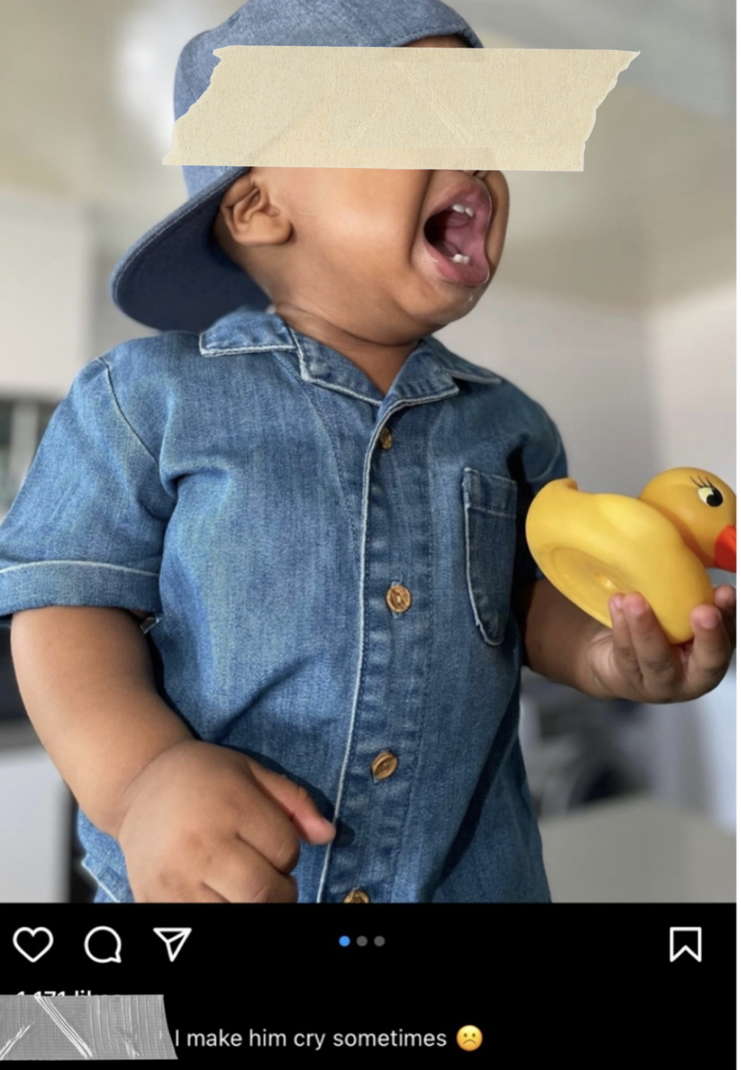
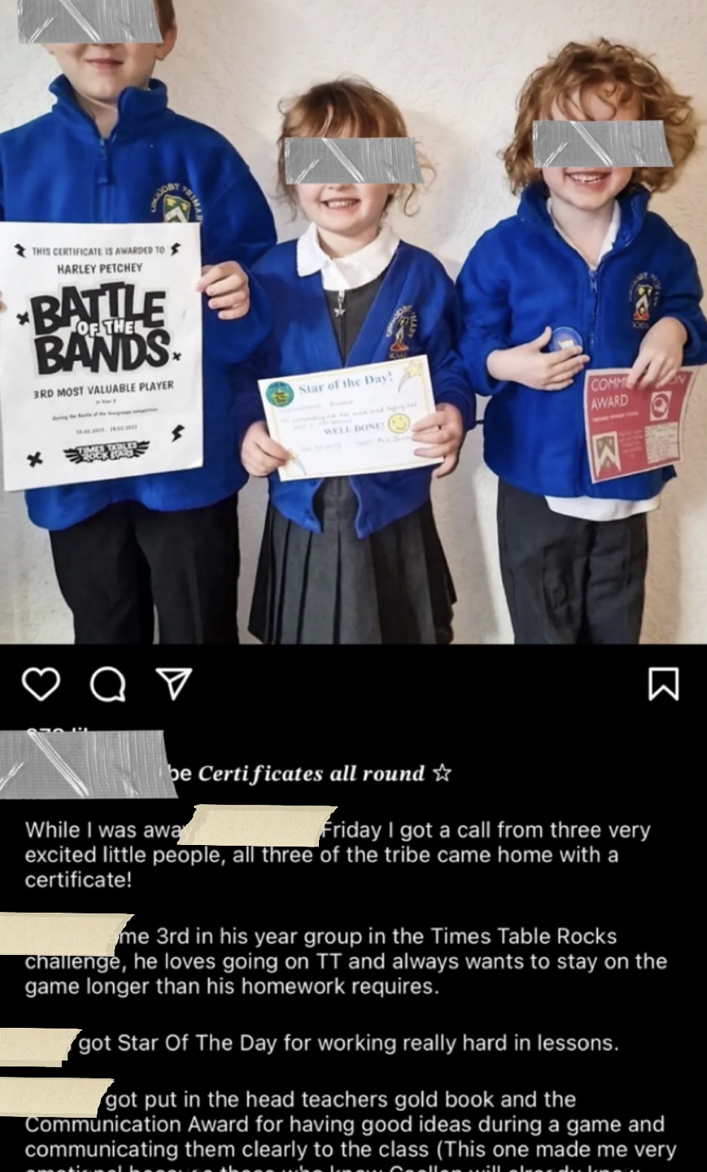
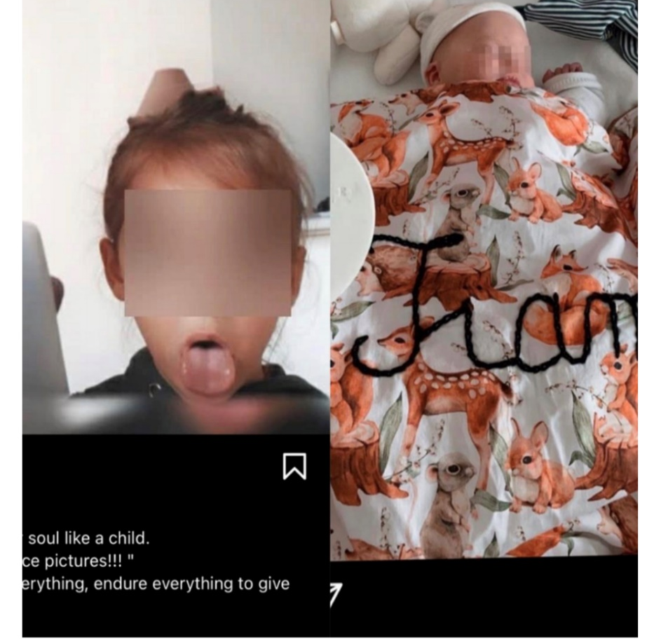
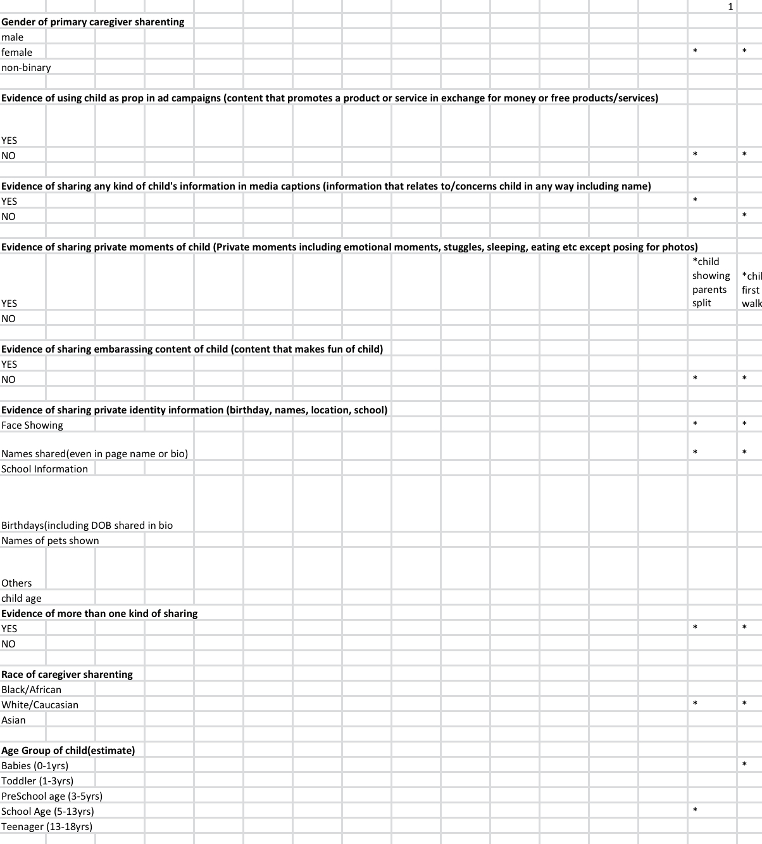
“Sharenting” and Child Privacy: A Content Analysis of
Parent Bloggers’ Instagram Posts Abiola Adebayo ( Dr. Rochelle Bergstrom, faculty advisor)
Department of Psychology, Minnesota State University Moorhead
Background:
Research has shown that parents, particularly mothers, share content about their children on the internet for various reasons, such as finding communities, showcasing their children's uniqueness, and demonstrating success (Lazard et al., 2019) - a phenomenon known as “sharenting.”
"Sharenting" has become more popular in recent years. Although it is intended to connect closer family members and friends or document important milestones, sharenting can potentially infringe a child's privacy and create risk of potential harm like identity theft, cyberbullying, or physical harm.
The current study aims to investigate whether parent bloggers violate their child's privacy and safety through sharing about their children. The study explores the different forms that “sharenting” may take and the extent to which children are personally identifiable through shared information.
Research Question:
Do parents share information on social media that potentially violates their child's privacy and/or safety?
Results:
Results showed that parent sharers were overwhelmingly female (84%).
Results:
Finally, all 50 (100%) posts analyzed contained more than one instance of sharenting.
20% (10) of parent sharers were Black/African American, 64% (32) were white/Caucasian (mainly from the USA and UK), and 8 (16%) were Asians.
36% of children being shared (18) were babies (0-1 years), 52% (26) were toddlers and preschoolers, and 12% (6) were school agers.
Example of parent sharing embarrassing content and private moment of child
Example of parent sharing private information and in caption
Example of parent sharing photos of children
Method:
A descriptive content analysis was conducted using a sample of 50 child-related Instagram posts comprising of photos and videos were randomly selected using specific parenting-related hashtags like “#mumsofinstagram”.
Selection was restricted to content published during 2022 and 2023.
Nine coding categories were identified, such as using children as props in advertising, sharing child's private moments, sharing private identity information, sharing embarrassing content, and various demographic variables (McTigue, 2021).
Post Content: 8% (4) of posts showed evidence of embarrassing moments, 52% (26) had evidence of private moments, 34% (17) had evidence of odd props, and 78% (39) had evidence of caption information.
Conclusion:
Overall, results indicate that the overwhelming majority of posts analyzed contained evidence of online parental sharing that could be considered a violation of a child's privacy, such as the sharing of private moments or information that clearly identifies the child in some way.
Discussion:
Sharenting can have negative consequences for children's privacy, identity, and future prospects. Malicious actors can use the information shared by parents for identity theft, cyberbullying, or other nefarious purposes.
Parents should weigh the risks and benefits of sharenting, find a balance between sharing and oversharing, and prioritize the safety and privacy of their children. By being mindful of the content they post online, parents can create a positive and safe digital footprint for their children, while also enjoying the benefits of online engagement.
One Excel spreadsheet was used to code all 50 posts.
The variables for caregiver/parent race included white/Caucasian, African American/Black, and Asian
The variables for the age group of children included babies (0-1 years), toddlers (1-3 years), preschool age (3-5 years), school age (5-13 years) and teenagers (13-18 years)
Coding Spreadsheet
Personal Identity: 47 (94%) posts showed the child's face, 49 (98%) contained the child’s name, 15 (30%) posted the child's birthdate,16 (32%) posted the child's age, and 2 (4%) shared the child’s school information.
References:
Lazard, L., Capdevila, R., Dann, C., Locke, A., & Roper, S. (2019). Sharenting: Pride, affect and the day‐to‐day politics of digital mothering. Social and Personality Psychology Compass, 13(4), e12443–n/a.
McTigue, M. (2021). Communication ethics of "Sharenting": A content analysis of Instagram mom mesoInfluencers. Student Research, 37. https://scholarship.depauw.edu/studentresearchother/37
Evaluate this poster:
Presentation ID: 9368
Scan the QR Code or go to:
https://bit.ly/sac2023-eval

