Slide 1
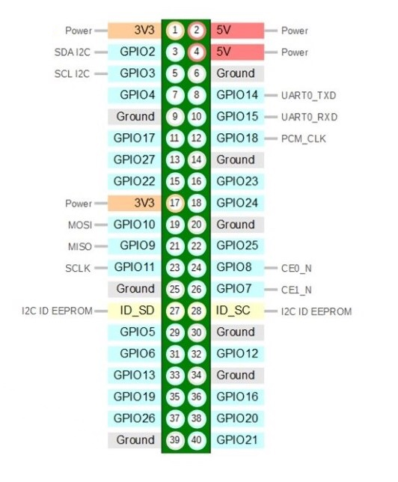
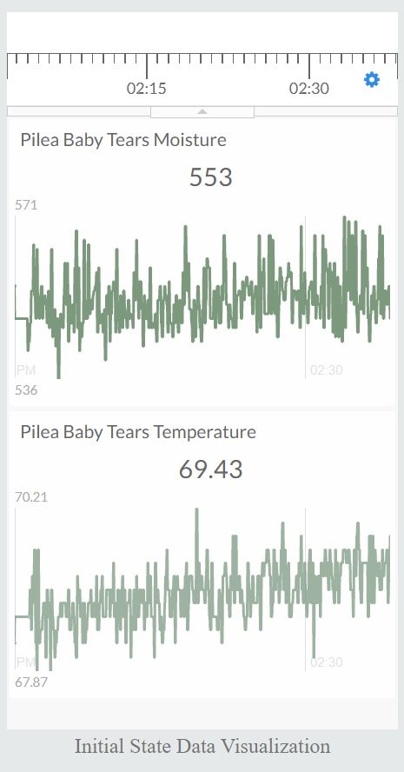
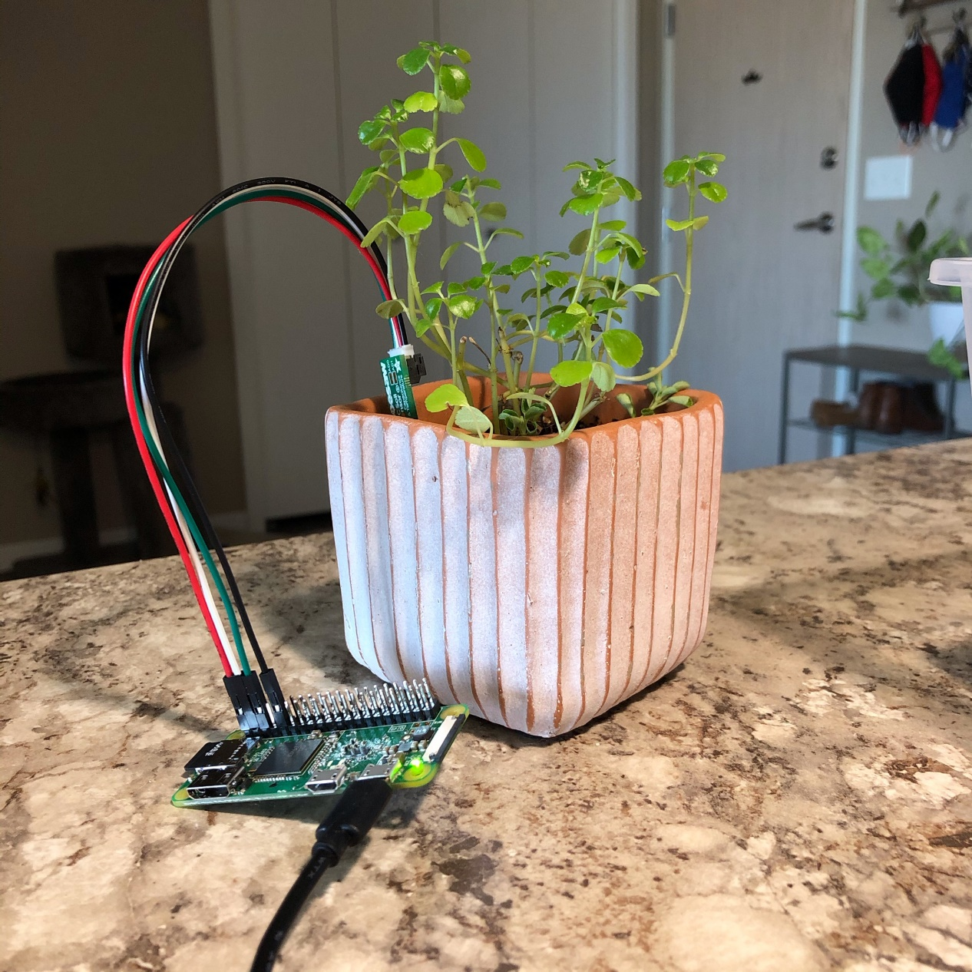
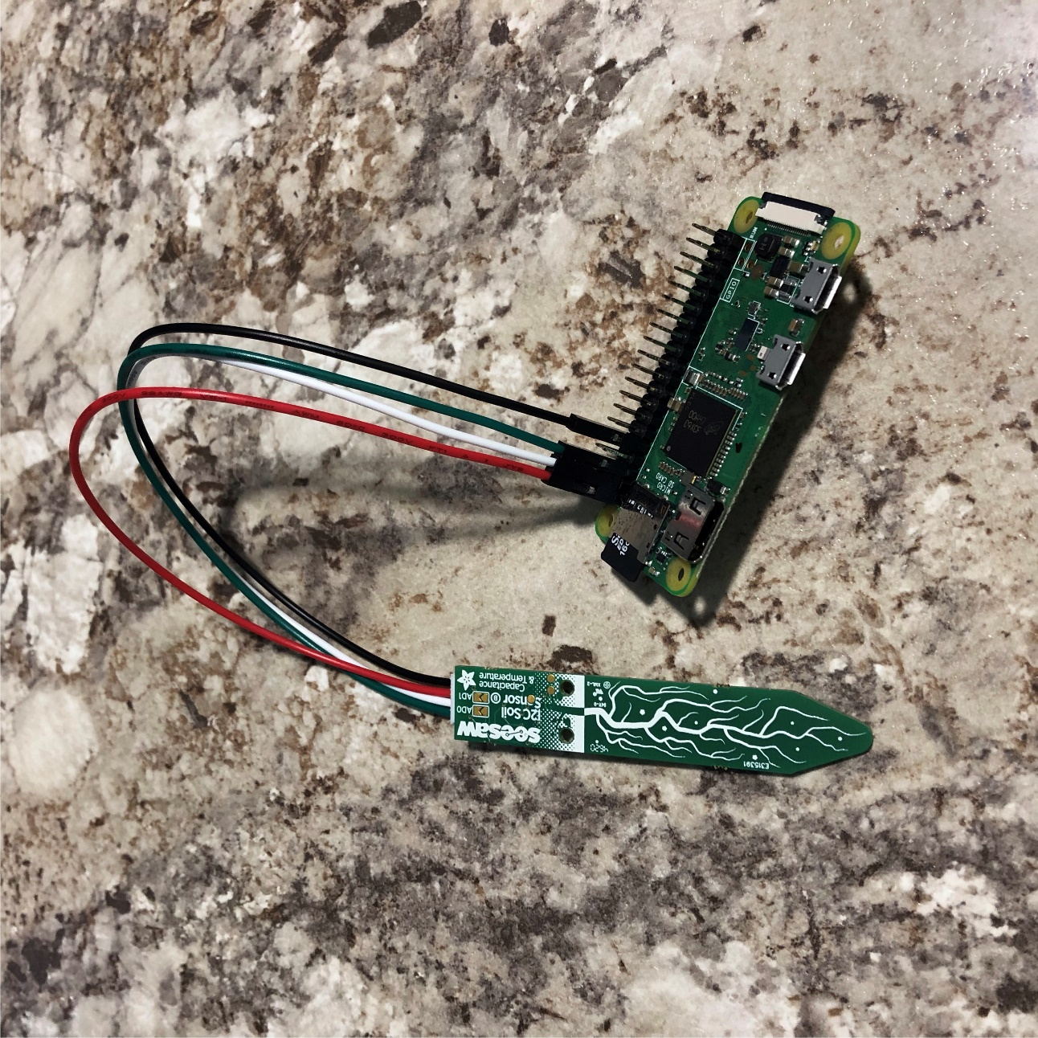
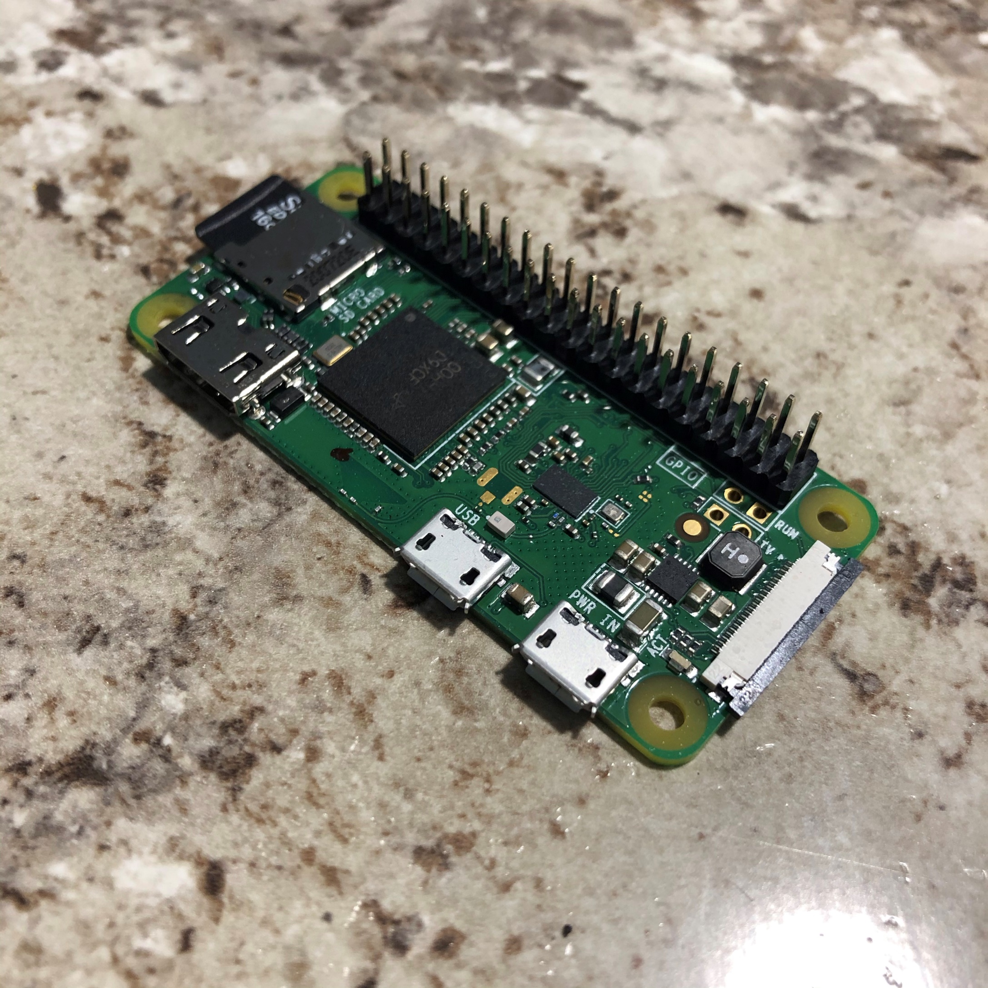
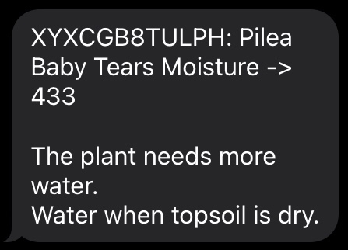
Raspberry Pi Plant Monitor
Caitlin Brooks
Computer Science and Information, Minnesota State University Moorhead, 1104 7th Avenue South, Moorhead, MN 56563
Abstract
It is an age of communication over the Internet. This includes the devices that are an everyday part of our lives. Internet of things (IOT) describes devices that use sensors, software, and other various technologies to exchange data over the Internet. With the use of a Raspberry Pi computer and a temperature and soil moisture sensor, the everyday household plants can be saved from underwatering and overwatering as well as making sure they’re in an appropriate temperature range for the plant being catered to. This data will then be streamed to a dashboard online for easy viewing of the information produced by the Raspberry Pi. This ease-of-use device is supposed to act as a guide for the appropriate level of care to give the monitored house plant.
Equipment List
Raspberry Pi Zero W (with Headers)
Adafruit STEMMA Soil Sensor – I2C Capacitive Moisture Sensor
JST PH 4-Pin to Female Socket Cable – I2C STEMMA Cable – 200mm
16GB SD Card with Raspberry Pi OS
5V 2.5A Switching Power Supply with 20 AWG MicroUSB Cable
Python Libraries Used
Libraries for Sensors
adafruit-blinka
Adafruit-circuitpython-seesaw
Library for Initial State
ISStreamer
Raspberry Pi
Pins Used in Connecting the Sensor
Red to Pin 1 (Power)
White to Pin 3 (SDA I2C)
Green to Pin 5 (SDL I2C)
Black to Pin 9 (Ground)
Data Visualization
The data visualization software (shown above) is an online resource: Initial State. This is where the data that is streamed by the Raspberry Pi is sent to be processed and is embedded into the adjacent online dashboard. This data monitors the soil moisture level of the plant’s potting soil and sends out the triggers to the associated email and phone numbers.
Left: Raspberry Pi Zero W pin layout
Sensor
The Adafruit STEMMA Soil Sensor has two functionalities within the singular sensor: temperature and moisture level.
Execution
Setting Up Raspberry Pi
Flash the SD card with Raspberry Pi OS
Add file containing the proper network information (SSID and network password)
Setting Up Run on Reboot
Command: sudo crontab –e
Within the file:
@reboot nohup python3
/home/pi/SoilMoistureProject/is_soil.py&
Left: Raspberry Pi Zero W (with Headers) and Adafruit Capacitive Moisture Sensor
Above: Full Raspberry Pi with Sensor working in Pilea Baby Tears
Alert Triggers
These triggers are designed in a fashion to alert the specified email/phone number holder that their plant’s conditions have fallen outside the specified range and requires attention. The triggers pictured are the alerts sent out when the soil of the plant has fallen outside of its desired range. Triggers can also be set for the temperature range in addition to just the soil moisture content, as temperature is a large factor for the overall health of the plant.
References
E. Adams, “How to Use a Soil Moisture Sensor to Keep Your Plants Alive,” Medium, 16-Nov-2020. [Online]. Available: https://medium.com/initial-state/how-to-use-a-soil-moisture-sensor-to-keepyour-plants-alive-51a2294b88e. [Accessed: 02-Feb-2021].
Ramakant Kumar 8-14-2019 at 12:38, John Doe 2-15-2020 at 18:07, and Binh Nguyen 7-25-2020 at 17:30, “Measuring Soil Moisture with the Raspberry Pi,” Raspberry Pi Tutorials. [Online]. Available: https://tutorials-raspberrypi.com/measuring-soil-moisture-with-raspberry-pi/. [Accessed: 02-Feb-2021].
“SSH (Secure Shell),” SSH (Secure Shell) - Raspberry Pi Documentation. [Online]. Available: https://www.raspberrypi.org/documentation/remote-access/ssh/. [Accessed: 09-Feb-2021].
Above: Raspberry Pi Zero W (with Headers)
Top: Alert trigger that is sent to the designated email.
Bottom: Alert trigger that is sent to the designated phone number

