Slide 1
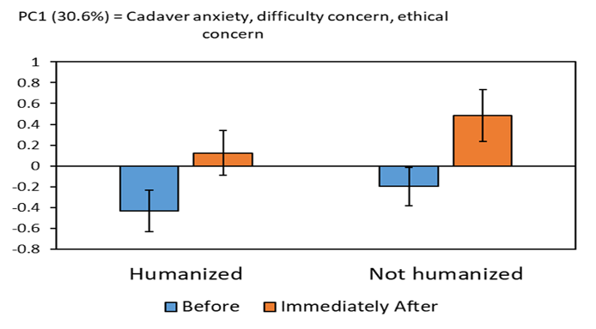
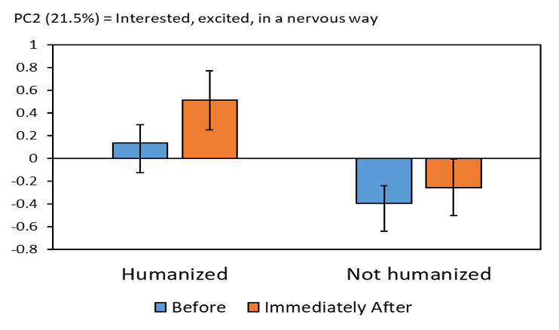
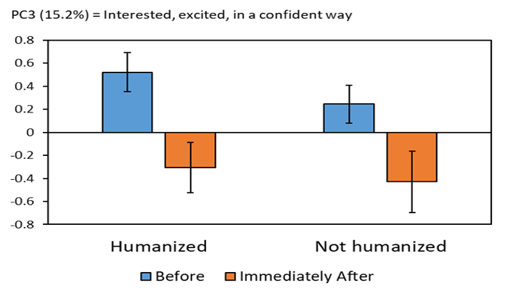
The Emotional Impact of “Humanizing Cadavers” In Undergraduate Nursing Students
Patricia Wisenden, Ryan Schrock, and Fathi Abdullahi
Biosciences, Minnesota State University Moorhead, 1104 7th Avenue South, Moorhead, MN 56563
Discussion:
In this study, giving medical and personable histories on each cadaver; “humanizing” them, did not overwhelmingly elicit greater anxiety towards cadaver use. However, it did elicit a greater apprehensive response towards interest in didactic use of human cadavers (2021). These finding led us to conclude that instructing human anatomy and physiology students may require specialized sensitivity towards what information is shared about each individual cadaver.
Heightened levels of nerves displayed with the cohort receiving a “humanizing” stimulus prior to their didactic experience with human cadavers may represent the pertinent aspect of receiving personable information therefore allowing for a greater possible human connection. To add to this, life in college can be stressful nevertheless amongst a global pandemic (Covid-19), totally shaking the dynamic of our everyday lives with onerous measures and increasing the anxiety amongst many college students (Son et al. 2020). Through further increasing arousal state with a given stimulus/experience is more likely to be remembered compared to those individuals with no initial emotional response to the given experience/ stimulus (Kensinger 2009). This can be applied to giving an “humanization” effect towards each individual cadaver.
We polled the effect of “humanizing” the dissection of human cadaver experience because we hypothesized that it would elicit a greater emotional response therefore playing a prevalent role within didactic studies of human dissection. Our results did not fully support this hypothesis (2021) where heighted apprehensiveness towards the interest of cadaver dissection was found but not an overall increase in anxiety levels with cadaver use overall.
Successful student retention and application requires adequate methods of instructing where every student feels comfortable and safe in the respective didactic setting (Tinto 2006). Thus, illustrating the prevalence of possibly preparing the students for what is to be expected in the dissection room and discuss any ethical/moral issues revolving around the use of human cadavers as a assuage into the human dissection experience (Plaisant et al. 2011).
Introduction
The learning of gross anatomy through the use of human cadaver dissection provides an intellectual, emotional and once in a lifetime learning experience. With human cadaver use being such an imperative way to learn human anatomy, many students are beginning to increasingly get this opportunity which equates into a multitude of different emotional responses amongst students of various different gender’s, religions and socio-demographics. However, to add this, the impediment to being able to fully maximize this unaccompanied experience/opportunity is the emotional influx amongst the student. With life experience, youth and allegiance towards their perspective (medical) endeavor possibly being in the outset stages, a greater risk level may plausibly be pertinent towards these types of individuals especially at the undergraduate level. The current study examines the possible emotional effects of “humanizing” and “non-humanizing” cadavers in a didactic setting for the purpose of dissection at the four-year undergraduate level. With moral connection being a vital part of the human personage and the increasing demand for medical professionals becoming increasingly relevant, identifying the best possible methods of instruction to alleviate negative response(s), may be a positive indicator for student retention for their perspective field, increased anatomical retention and application and cultivation of continuous professional development.
t
`
Figure 1: Mean (+/-) on PC1(Cadaver anxiety, difficulty concern, and ethical concern) for students in A&P I, II.
Methods
Minnesota state University Moorhead is a four-year accredited liberal arts college located in Western Minnesota.
§ In 2021, a sociodemographic and questionnaire was conducted with the Human anatomy and Physiology I & II (A&P I, II) students at five various time periods in the semester: Prior to first dissection/lab experience (time 1), Immediately following first dissection/lab experience (time 2), 6 weeks post initial dissection experience (time 3), 9 weeks post initial dissection experience (start of new course A&P II) and twelve weeks after the first dissection (end of semester) experience (time 5).
§ The questionnaire consisted of two main components: Component 1 collected “descripting” data on socio-demographics of age, gender, race, religion, religiosity and component 2 collected “indicating” data of student responses towards cadaver dissection.
§ Ethnicity was designated as one of white-European heritage, African-American, Native-American, Asian, Hispanic and other (please specify).
§ Religion (affiliation) was designated as Christian, Muslim, Buddhist or no religious community: Christian; Christian-Catholic, Christian-Lutheran, Christian other (please specify). Muslim; please specify and Buddhist.
§ Religiosity was categorized as a response to the indefinite utterance “I consider myself a religious person”; Strongly agree, agree, neutral, disagree or strongly disagree.
A principal component analysis (PCA) was applied to reduce the dimensionality of the data matrix and legibly reveal nascent trends.
Results
PCA Statistical analysis & ANOVA
Summary indices: PC1 (30.6%), PC2 (21.5%), PC3(15.2%)
No significance (PC1) towards cadaver anxiety
Significance (PC2) found in “Humanizing” subjects in apprehensiveness towards didactic use of cadavers
(PC3) Humanization no significance
Figure 2: Mean (+/-) on PC2 (Interested, Excited, in a nervous way) for students in A&P I, II.
Reference:
Son, C., Hegde, S., Smith, A., Wang, X., & Sasangohar, F. (2020). Effects of COVID-19 on College Students' Mental Health in the United States: Interview Survey Study. Journal of medical Internet research, 22(9), e21279. https://doi.org/10.2196/21279
Kensinger E. A. (2009). Remembering the Details: Effects of Emotion. Emotion review : journal of the International Society for Research on Emotion, 1(2), 99–113. https://doi.org/10.1177/1754073908100432
Plaisant, O., Courtois, R., Toussaint, P., Mendelsohn, G., John, O., Delmas, V., &amp; Moxham, B. (2011, August 25). Medical students' attitudes toward the anatomy dissection room in relation to personality. Retrieved April 13, 2021, from https://anatomypubs.onlinelibrary.wiley.com/doi/epdf/10.1002/ase.251
Tinto, V. 2006. Research and practice of student retention: What next?. J. College Student Retention 8: 1-19.
Wisenden PA, Budke KJ, Klemetson CJ, Kurtti TR, Patel CM, Schwantz TL, Wisenden BD. Emotional response of undergraduates to cadaver dissection. Clin Anat. 2018 Mar;31(2):224-230. doi: 10.1002/ca.22992. Epub 2017 Oct 27. PMID: 28948647.
Figure 3: Mean (+/-) on PC3(Interested, Excited, in a confident way) for students in A&P I, II.

