Slide 1
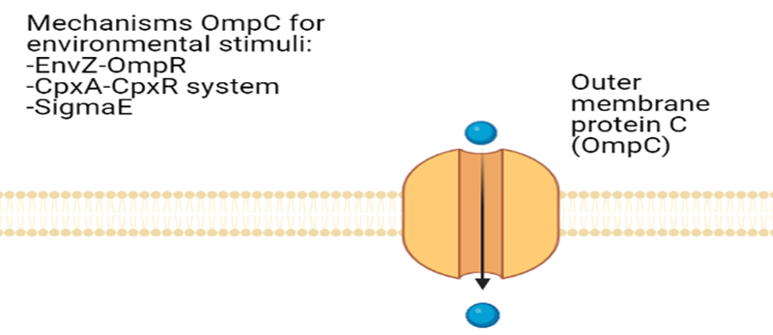
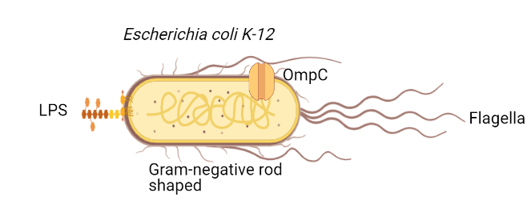
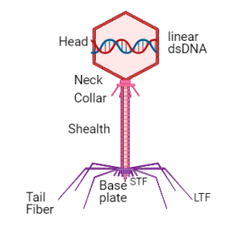
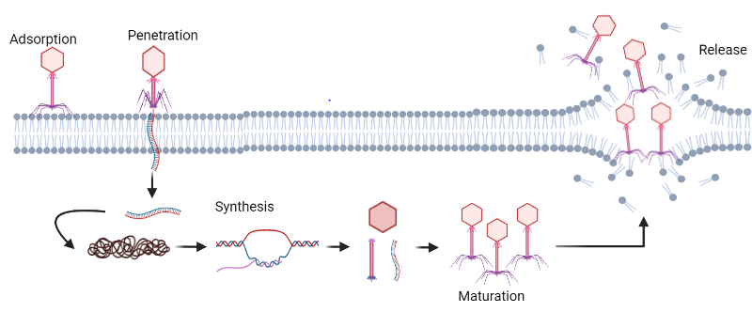
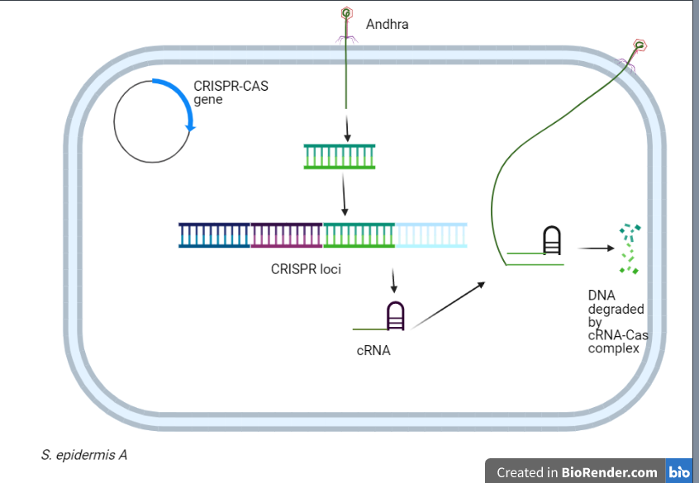
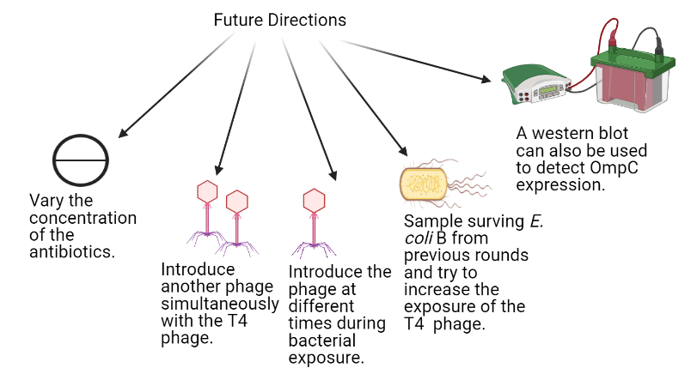
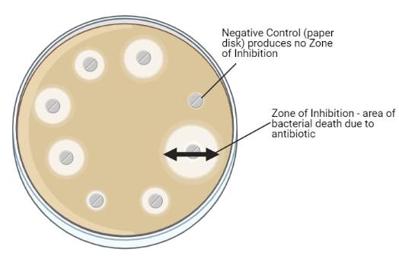
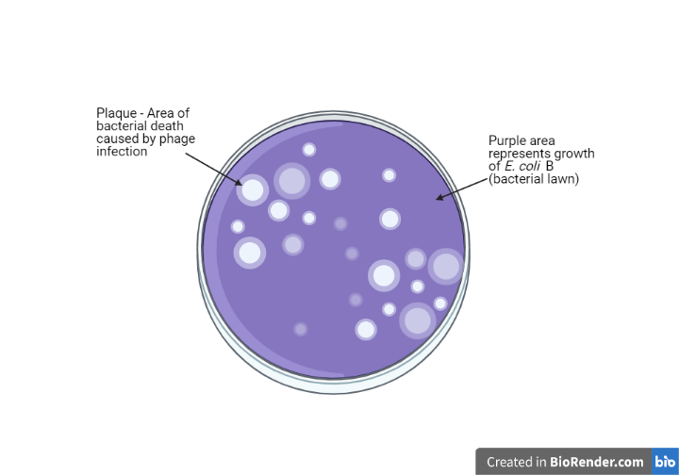
Phage Antibiotic Antagonism of Escherichia coli B and T4 Phage
Mikaela Griechen, Miranda Griechen, Tyler Mueller
Immunobiology (BIOL 430) at MSUM Spring 2021
Biosciences Department, Minnesota State University Moorhead, 1104 7th Avenue South, Moorhead, MN 56563
Background Information
Antibiotic resistance has resulted in researchers finding new methods for treating diseases caused by pathogenic bacteria.
Antibiotic resistance forms due to the presence of plasmids and mutations in the bacterial genome.
Phage Antibiotic synergy has been reported when exposing bacteria to phages in previous studies (3).
Bacterial immune mechanisms, specifically those that aid against bacteriophages, have been exploited by researchers as a potential treatment for infection and diseases. These mechanism includes Superinfection (Sie), Abortive infection, surface modification, etc.
Escherichia coli B is a bacteria that contains an outer membrane with receptors, porins, lipopolysaccharides, and other surface molecules that aid in defense and metabolism.
Escherichia coli B is also a motile bacteria, (flagella) a mesophile, and facultative anaerobe.
Fig 1.1 Escherichia coli B . Created by Miranda Griechen, Mikaela Griechen, and Tyler Mueller using www.biorender.com
T4 bacteriophage goes after E. coli., specifically OmpC and lipopolysaccharide (LPS) that is found on the outer membrane (5,7).
The T4 Bacteriophage uses this porin protein and LPS for attachment to initiate the lytic cycle (5,6,7).
Fig. 1.2 T4 Bacteriophage and the lytic cycle . Created by Miranda Griechen, Mikaela Griechen, and Tyler Mueller using www.biorender.com.
Research Question
How does the introduction of the T4 phage affect the antibiotic susceptibility of E. coli B?
Results
Discussion, Conclusion, and Future Directions
One mechanism, otherwise known as surface modification, is used to prevent attachment of surface proteins by blocking and masking the protein or by mutations in gene expression. It is homologous to the innate immune system in vertebrates (1, 3).
Previous studies have shown that phage interaction causes surface modification to occur. Surface modification affecting antibiotic resistance has not been readily studied (4, 3).
Fig 1.6 The nature of surface modification and outer membrane protein C (OmpC) . Created by Miranda Griechen, Mikaela Griechen, and Tyler Mueller using www.biorender.com
Pathways that OmpC uses in the presence of environmental stressors to the outer membrane:
EnvZ-OmpR, CpxA-CpxR, and Sigma^{E} (σ^{E} ) systems (2).
These mechanisms, although not entirely understood, are needed for gene expression (Silencing or expressing) for the ompC gene responsible for regulating the function of OmpC protein through phosphorylated OmpR (2).
Another mechanism is CRISPR-Cas System which is homologous to the adaptive immune system.
The CRISPR-Cas system provides immunological memory for the organism (1, 3, 4).
Fig 1.7 CRISPR-Cas System in a bacterial cell. Created by Miranda Griechen, Mikaela Griechen, and Tyler Mueller using www.biorender.com.
From previous literature, we think that it is possible that the phage and the antibiotic will eventually have a synergistic relationship with the antibiotics due to either surface modification or the CRISPR-Cas System.
Fig 1.8 Future Directions for the experiment. Created by Miranda Griechen, Mikaela Griechen, and Tyler Mueller using www.biorender.com.
E. coli B+antibiotics
E. coli B+antibiotics+T4 phage
S= sensitive R=resistant
S
R
Fig. 1.4 The effect of antibiotic exposure with phage exposure on the size of the average zone of inhibition for E. coli B for the following antibiotics. F_{1,13:} P=0.066 and F=4.077 from the ANOVA test. Created by Miranda Griechen, Mikaela Griechen, and Tyler Mueller using Excel.
Disk Diffusion
E. coli B + Antibiotics
Disk Diffusion plaque assay
E. coli B+ Antibiotics + T4 phage
Materials and Methods
TSB-soaked filter paper
of E. coli B
TSB-soaked filter paper
E. coli B + of T4 phage
References
Orzechowska B., Mohammed M. 2019. The War between Bacteria and Bacteriophages. IntechOpen.1(6): 1-22
Batchelor E., Walthers D., Kenney J. L., Goulian M. 2005. The Escherichia coli CpxA-CpxR Envelope Stress Response Protein A on Adsorption of Bacteriophages to Staphylococcus aureus. American Society of Microbiology. 14 (2): 198-202 System Regulates Expression of the Porins OmpF and OmpC. Journal of Bacteriology. 187 (16): 5723-5731
van Houte Stineke, Buckling Angus, Westra R. Edze. 2016. Evolutionary Ecology of Prokaryotic Immune Mechanisms. Microbiology and Molecular Biology Reviews. 80 (3): 745-763.
Abedon, Stephen. 2012. Bacterial ‘immunity’ against bacteriophages. Bacteriophage. 2:50-54.
Rabbani I., Radoja U., Ray S., Selim A., Weston C. 2004. The Dynamics of Bacteriophage T4 Binding to Escherichia coli. Journal of Experimental Microbiology and Immunology (JEMI) 5: 61-64.
Yap M. L., Rossman M.G. 2014. Structure and function of bacteriophage T4. Future Microbiology. 9: 1319-1327
Nordstrӧm K., Forsgren A. 1974. Effect of Protein A on Adsorption of Bacteriophages to Staphylococcus aureus. American Society of Microbiology. 14 (2): 198-202.
Liu Gu, C., Green, S.I., Min L., Clark, J.R., Salazar K.C., Terwilliger, A.L., Kaplan, H.B., Trautner, R.F., Maresso, A.W. 2020. Phage-Antibiotic Synergy Is Driven by a Unique Combination of Antibacterial Mechanism of Action and Stoichiometry. American Society of Microbiology. 11(4): e01462-20.
Chaudhry, W. N., Concepcion-Acevedo, J., Park, T., Andleeb, S., Bull, J. J., and Levin, B. R. 2017. Synergy and order effects of antibiotics and phages in killing Pseudomonas aeruginosa biofilms. PLoS ONE 12: e0168615.
Aditi, F.Y., Rahman S.S., Hossain, M Md. 2017. A Study on Microbiologist Status of Mineral Drinking Water. The Open Microbiology Journal. (11): 31-44.
11. Benedict, K.M., Gow, S.P., Checkley, S., Booker, C.W., McAllister T.A., Morley, P.S. 2013. Methodological comparisons for antimicrobial resistance surveillance in feedlot cattle. BMC Vet Res 9: 216.
Fig. 1.5 The effect of antibiotic exposure with phage exposure on the size of the average zone of inhibition for E. coli B for the following antibiotics. F_{1,13}: P= 0.066 and the F value is 4.077 from the ANOVA test. Created by Miranda Griechen, Mikaela Griechen, and Tyler Mueller using Excel.
Acknowledgements
We would like to thank Todd Nolte (Lab Manager, Biosciences Department, MSUM) for making all the supplies available for our project and Dr. Sumali Pandey for her guidance.
Fig. 1.3 The Disk Diffusion of E. coli B with zones of inhibition and the affects of the T4 bacteriophage. Created by Tyler Mueller, Mikaela Griechen, and Miranda Griechen using www.biorender.com.
Contract Information
Miranda Griechen: miranda.griechen@go.mnstate.edu Mikaela Griechen: mikaela.griechen@go.mnstate.edu Tyler Mueller: tyler.mueller@go.mnstate.edu

